Slide 1
Emergency Preparedness
Leslie Ocampo
Joselyn Villaseñor

Slide 2
How does one deal with an emergency?

Slide 3
Types of emergencies
Calling 911
Traffic accident
Fire
Home accidents
Vocabulary

Slide 4
Don’t panic.

Slide 5


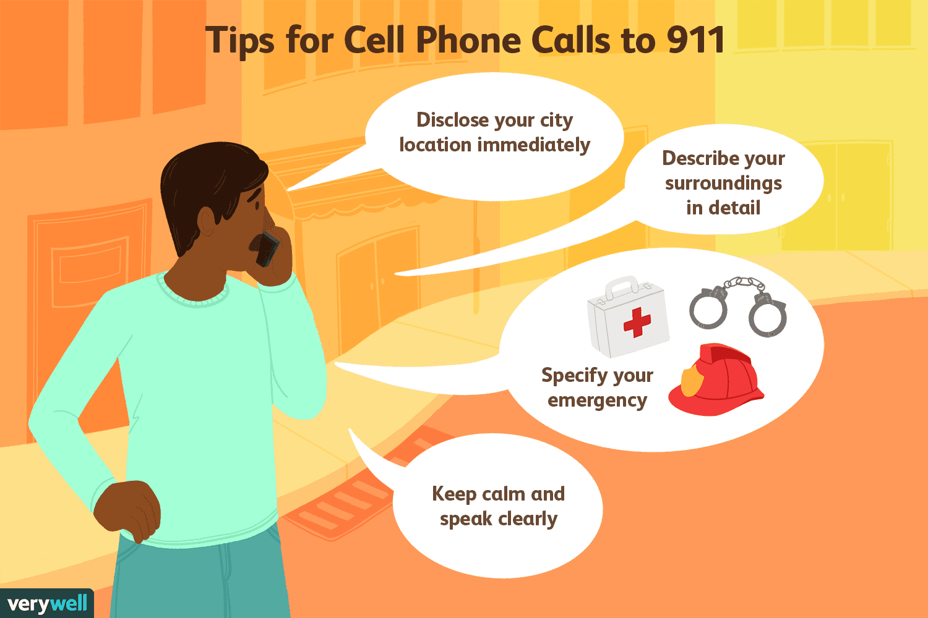
Calling 911
Be calm
911 Procedure - what kinds of questions are asked?
Vocab to know
How to follow instructions.
https://www.youtube.com/watch?v=UjcalwvSEXQ- Emergency vocabulary
https://www.youtube.com/watch?v=Q62UwEPPnrg- First aid

Slide 6
Questions asked
Location
Patient description
Instructions
https://www.youtube.com/watch?v=tsjhKPErFAA

Slide 7
Traffic Accident

Slide 8

Traffic Accident
Car accident is the most general term – it can describe any type of accident, major or minor, and it can involve only one car or two or more cars
Speeding – driving faster than the speed limit
Sample Question:
Where are you? Who needs help? Are they breathing?
Sample Lesson Plan:
https://www.espressoenglish.net/wp-content/uploads/2014/01/VBC2-Lesson1-Free-Sample.pdf

Slide 9
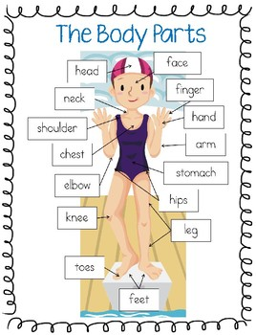
Accidents
Learn about parts of the body
Pain
It hurts
Ache
Numb

Slide 10
Fire

Slide 11
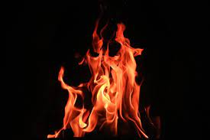
Fire Emergency
If your house in on fire, you should go outside quickly, call 911, and wait for the fire truck.
Practice home address
Is the fire at your house? Neighbor?
Do you know where the fire started?
Who/What/When/Where
Reading Lesson:
https://www.elcivics.com/fireman.pdf

Slide 12

Sample Dialogue
Operator: 911 Where is your emergency?
Caller:
Operator: What is your phone number?
Caller:
Operator: What is happening?
Caller:
Operator: We are sending the Fire Department.
Operator: Are there people in the house?
Caller:
Operator: Do not go inside. Call to them to evacuate. Evacuate your own house and go to safety. Please hang up now.

Slide 13
Home Accidents

Slide 14
When reporting an accident at home...
Be calm
Describe the situation
Address
Follow instructions
Vocabulary
hot pan/pot
hot curling iron
knife
window
iron
medicines
gasoline
pool
insecticides
natural gas
balcony
toilets
staircase
stove/oven
stool/ladder
yard tools
fireplace
cellar /attic
bathtub
bad dog
tall pieces of furniture

Slide 15
911 Call
https://youtu.be/g2UrD_x2xl4

Slide 16
More resources:
https://www.face.edu/Page/813

Slide 17
Topics of conversation:

Slide 18
Accidents at home...
What is the most dangerous thing in your home? How can your home be made less dangerous?
What is the most dangerous thing in your home for a child? How can it be made less dangerous?
What is the most dangerous thing in your home for an elderly person? How can it be made less dangerous?
What dangers can be found in the kitchen that can cause accidents?
What can be done to prevent kitchen accidents?
What can a parent do to childproof a kitchen?
What dangers can be found in bathrooms that can cause accidents?
What can be done to prevent bathroom accidents?
What can a parent do to childproof a bathroom?
What dangers can be found outside the home in the yard that can cause accidents?
What can be done to prevent yard accidents?
What can a parent do to childproof the yard?
What other dangers can be found in a home in bedrooms, laundry rooms, garages, and living areas?
What can be done throughout the house to prevent accidents?
What can a parent do to childproof the different rooms of the home?
Where at home would you put your first aid kit?
What would you have in it?

