Slide 1



Welcome!
¡Bienvenidxs!

Slide 2

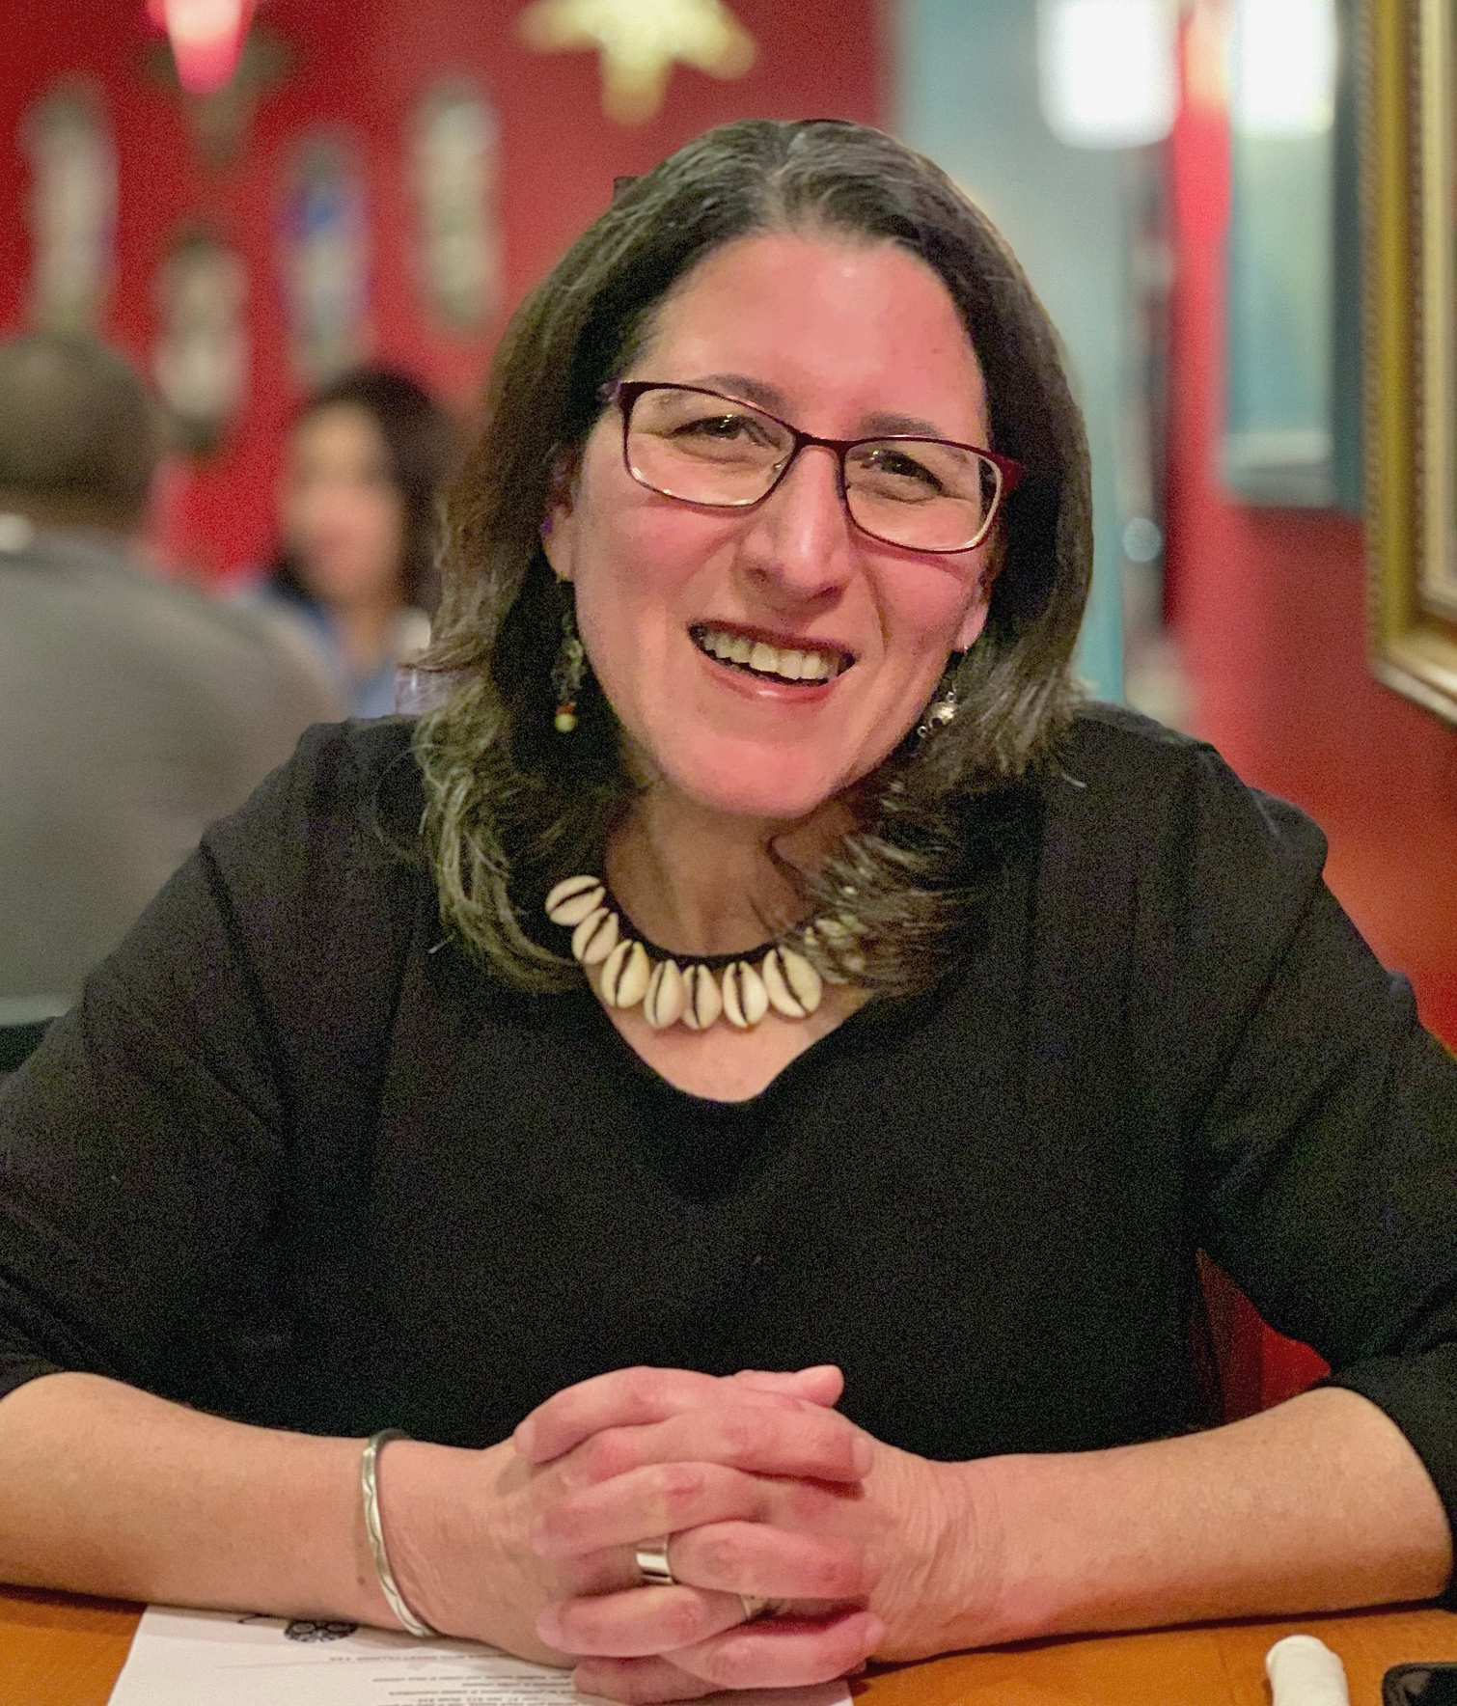
History
The Hispanic Liaison / El Vínculo Hispano is a
501c3 nonprofit organization.
EVH was founded in 1995 by a Latina immigrant to address the unmet needs of the growing Hispanic community. We were among the first Latinx organizations to form in NC.
We have helped thousands of adults, youth and children adjust to life in the US, access the services they need, and affirm their rights.
We serve as a bridge between the Latinx community and non-profits, government and law enforcement agencies.

Slide 3
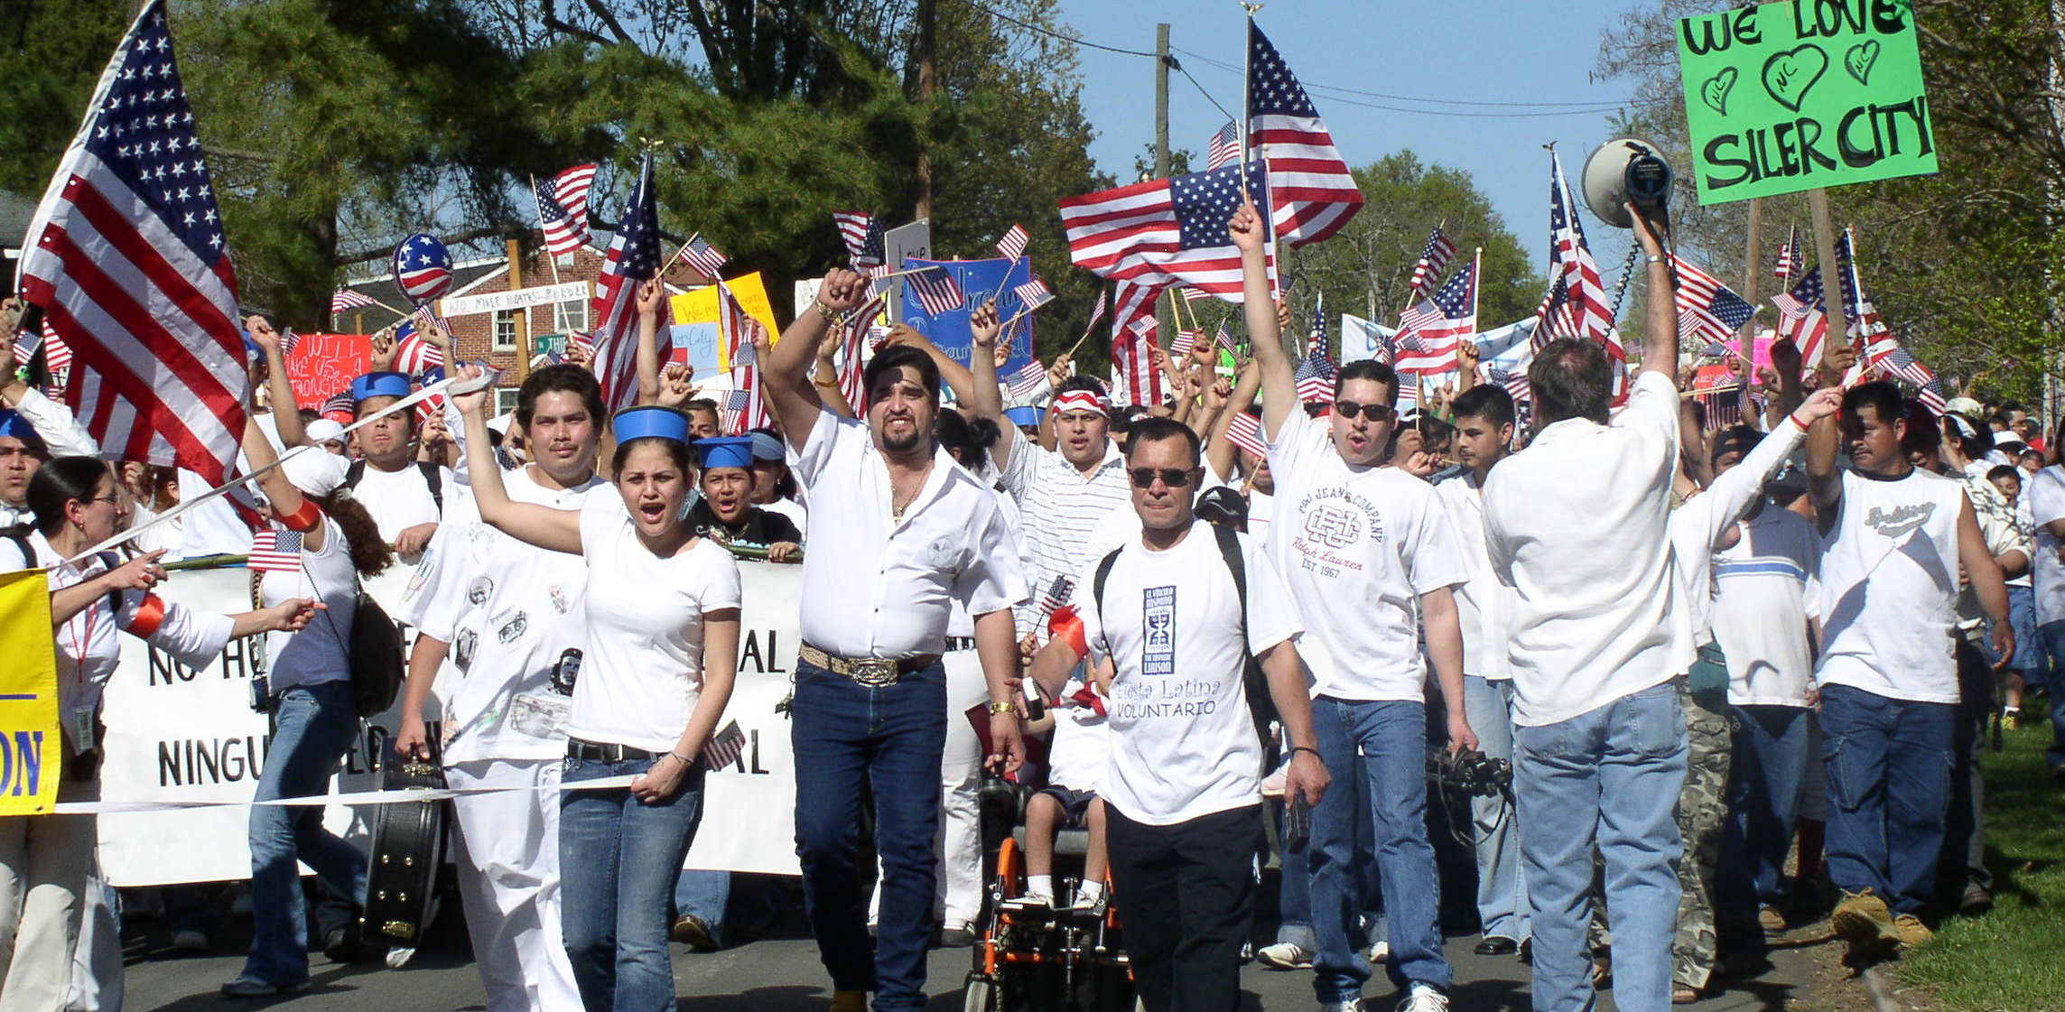
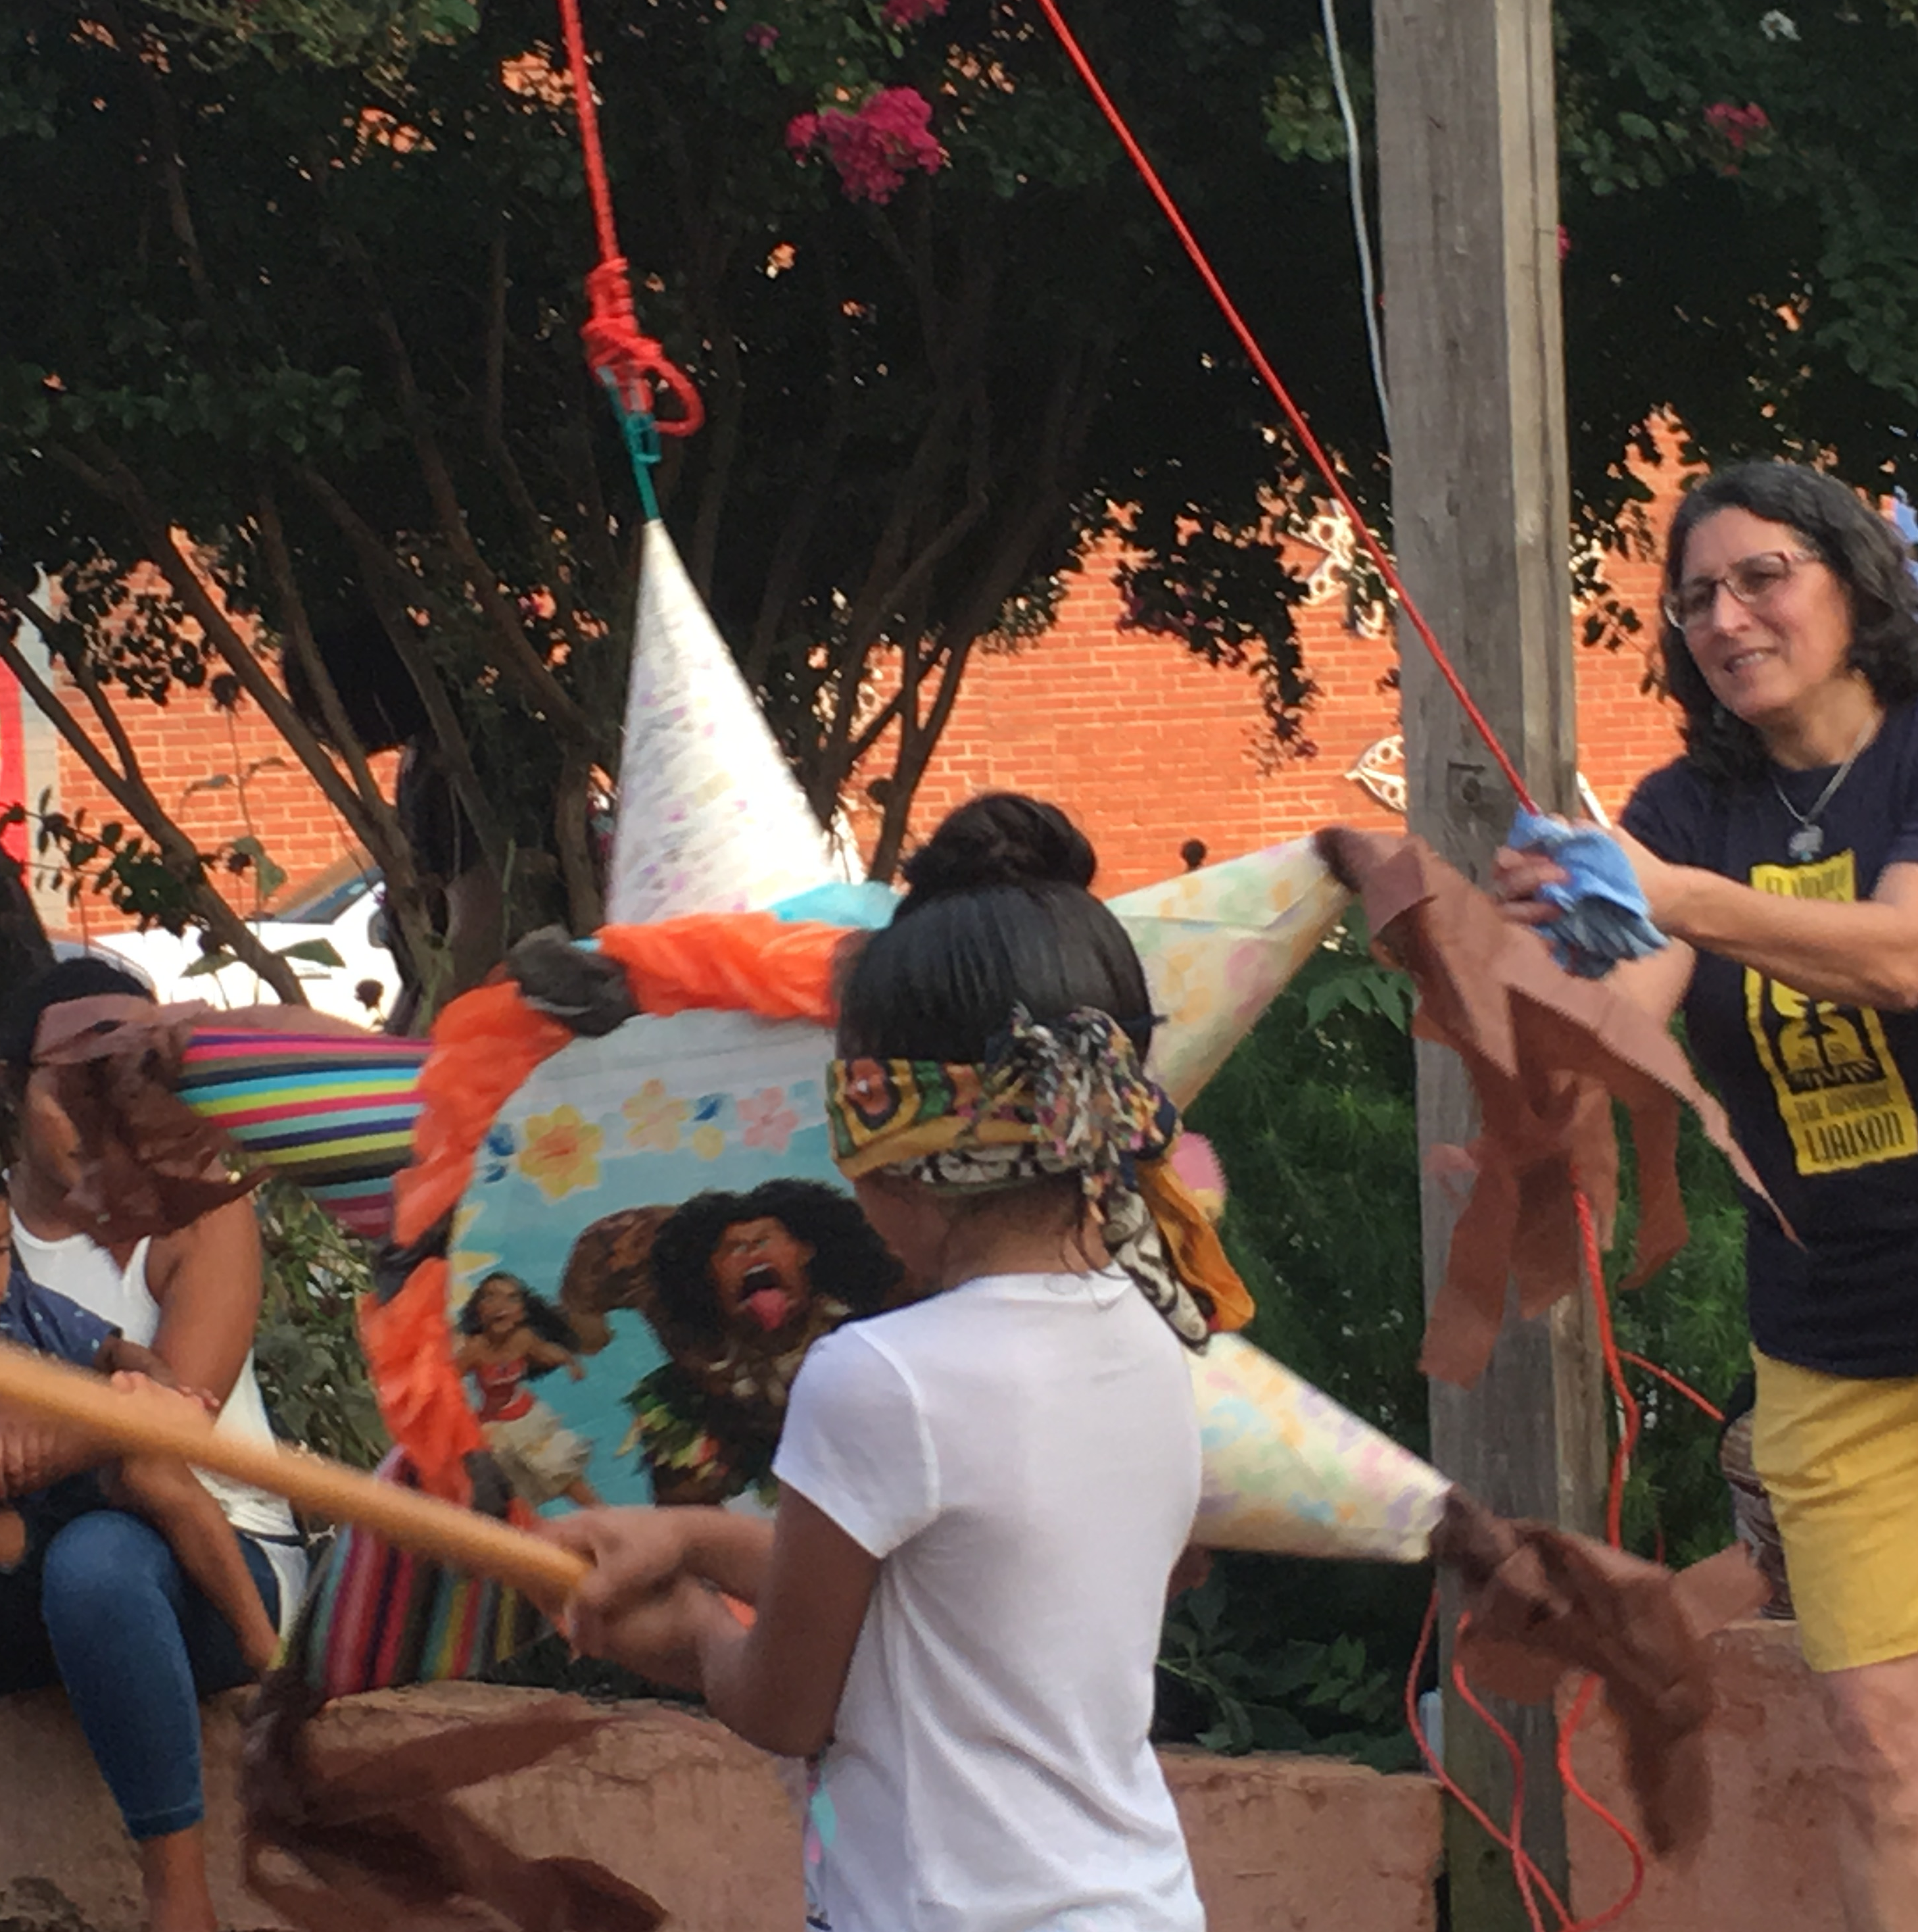
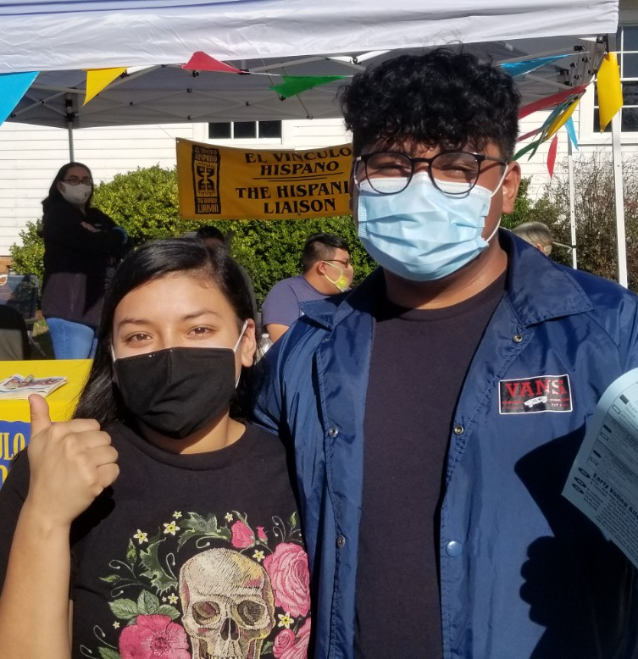

Mission
To foster intercultural understanding and to empower Hispanics to overcome the challenges they face and make their voices heard in the community.

Slide 4

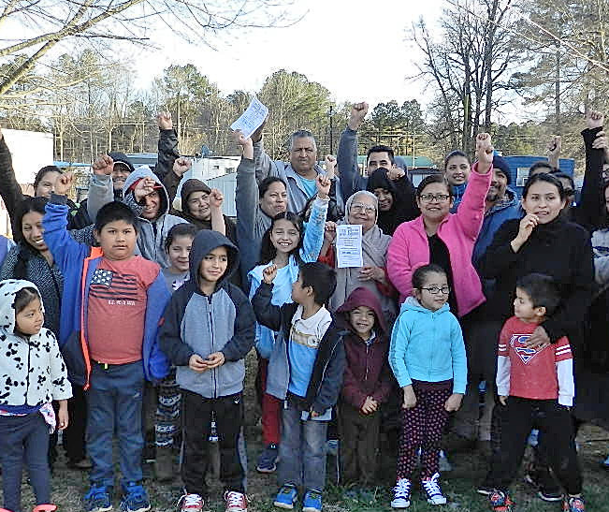
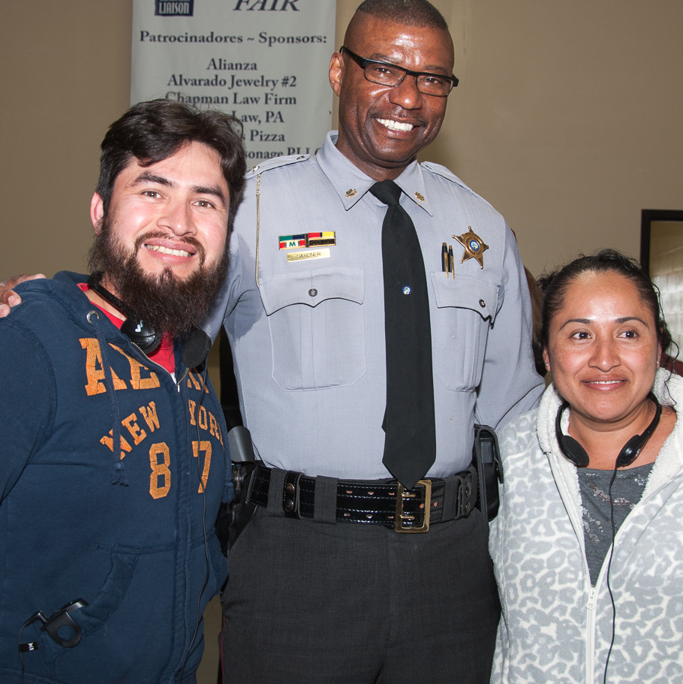
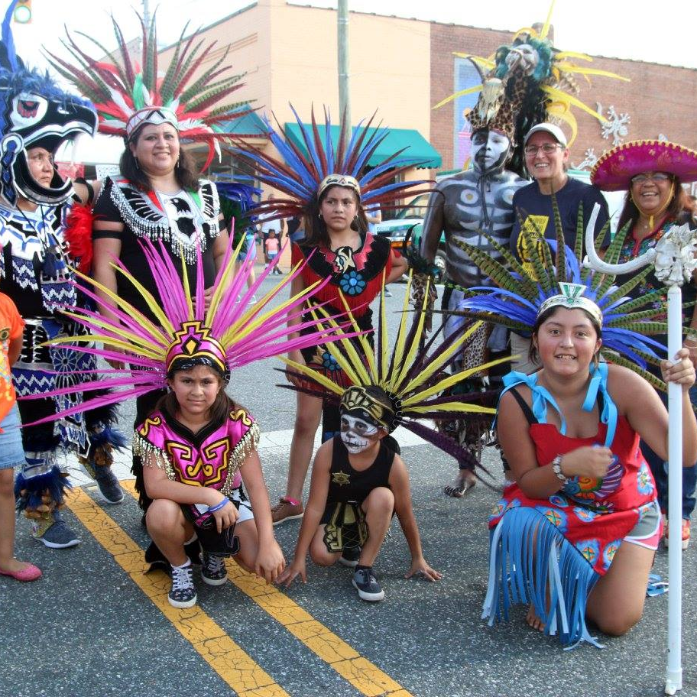
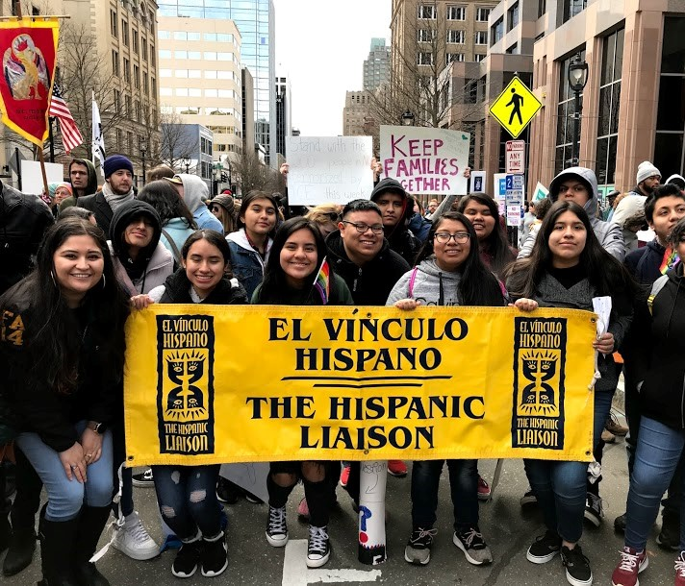
Vision
EVH is a community-centered organization grounded in Hispanic culture.
We commit to being transparent and accountable to our community, volunteers, partners, donors, allies and supporters.
We believe that social change is best achieved through collaboration, community empowerment and civic engagement.

Slide 5
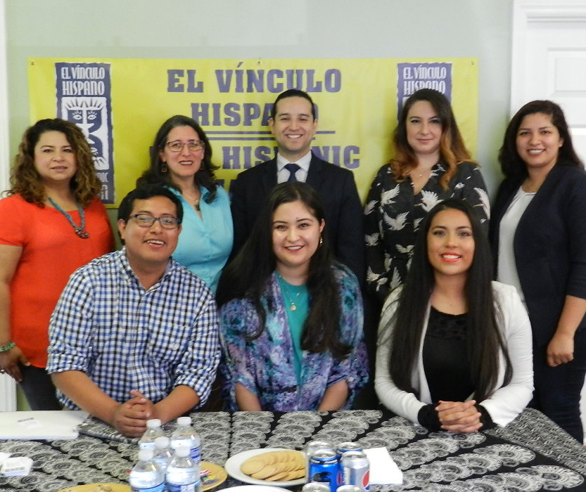


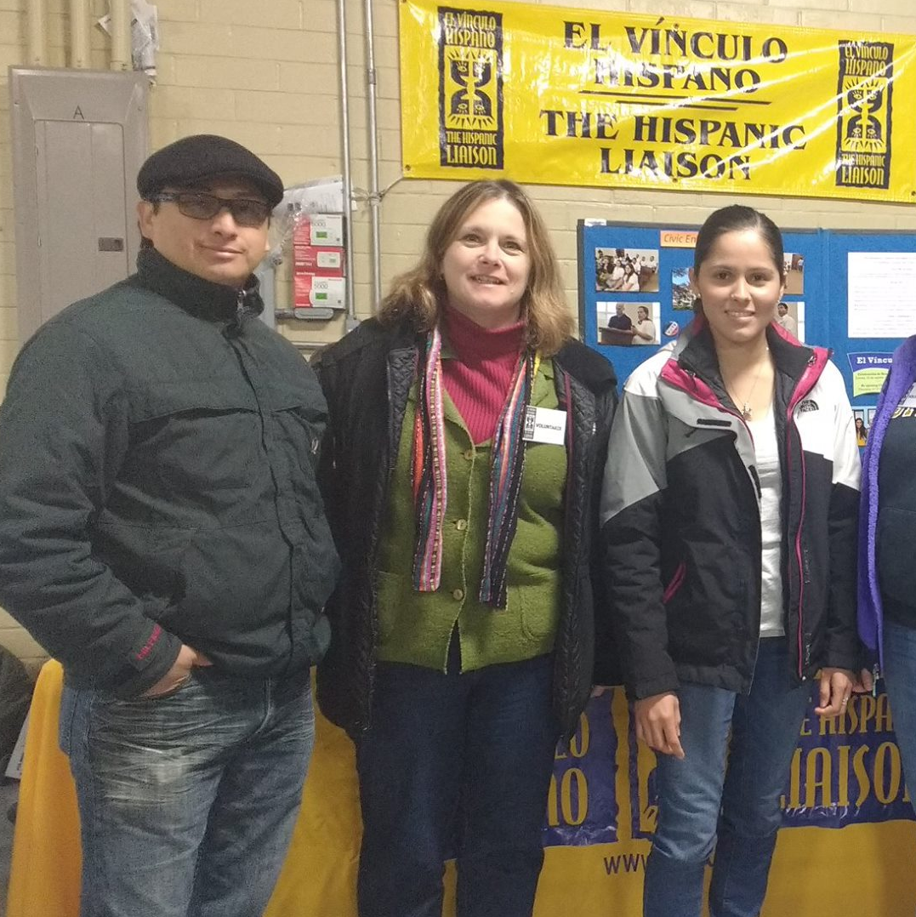

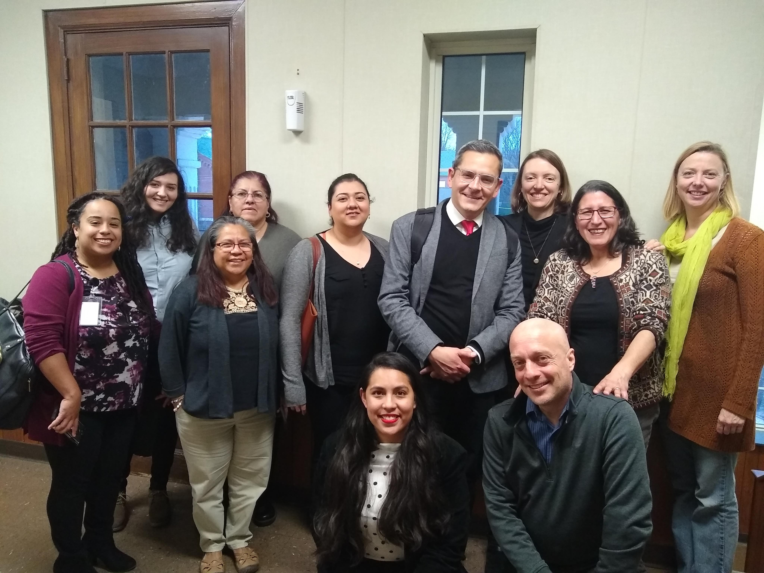


Goals
Increase access to services and opportunities, individually and collectively
Foment civic participation and community engagement
Protect and advance the rights of immigrants and the Latinx community
Promote an equitable, just, and inclusive society for all

Slide 6
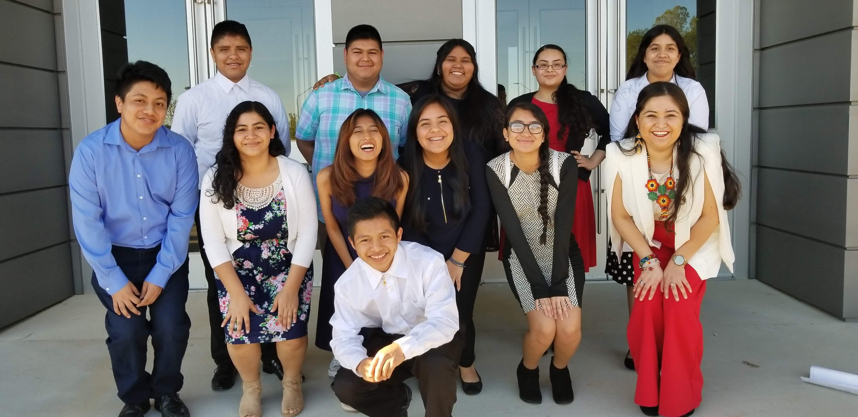

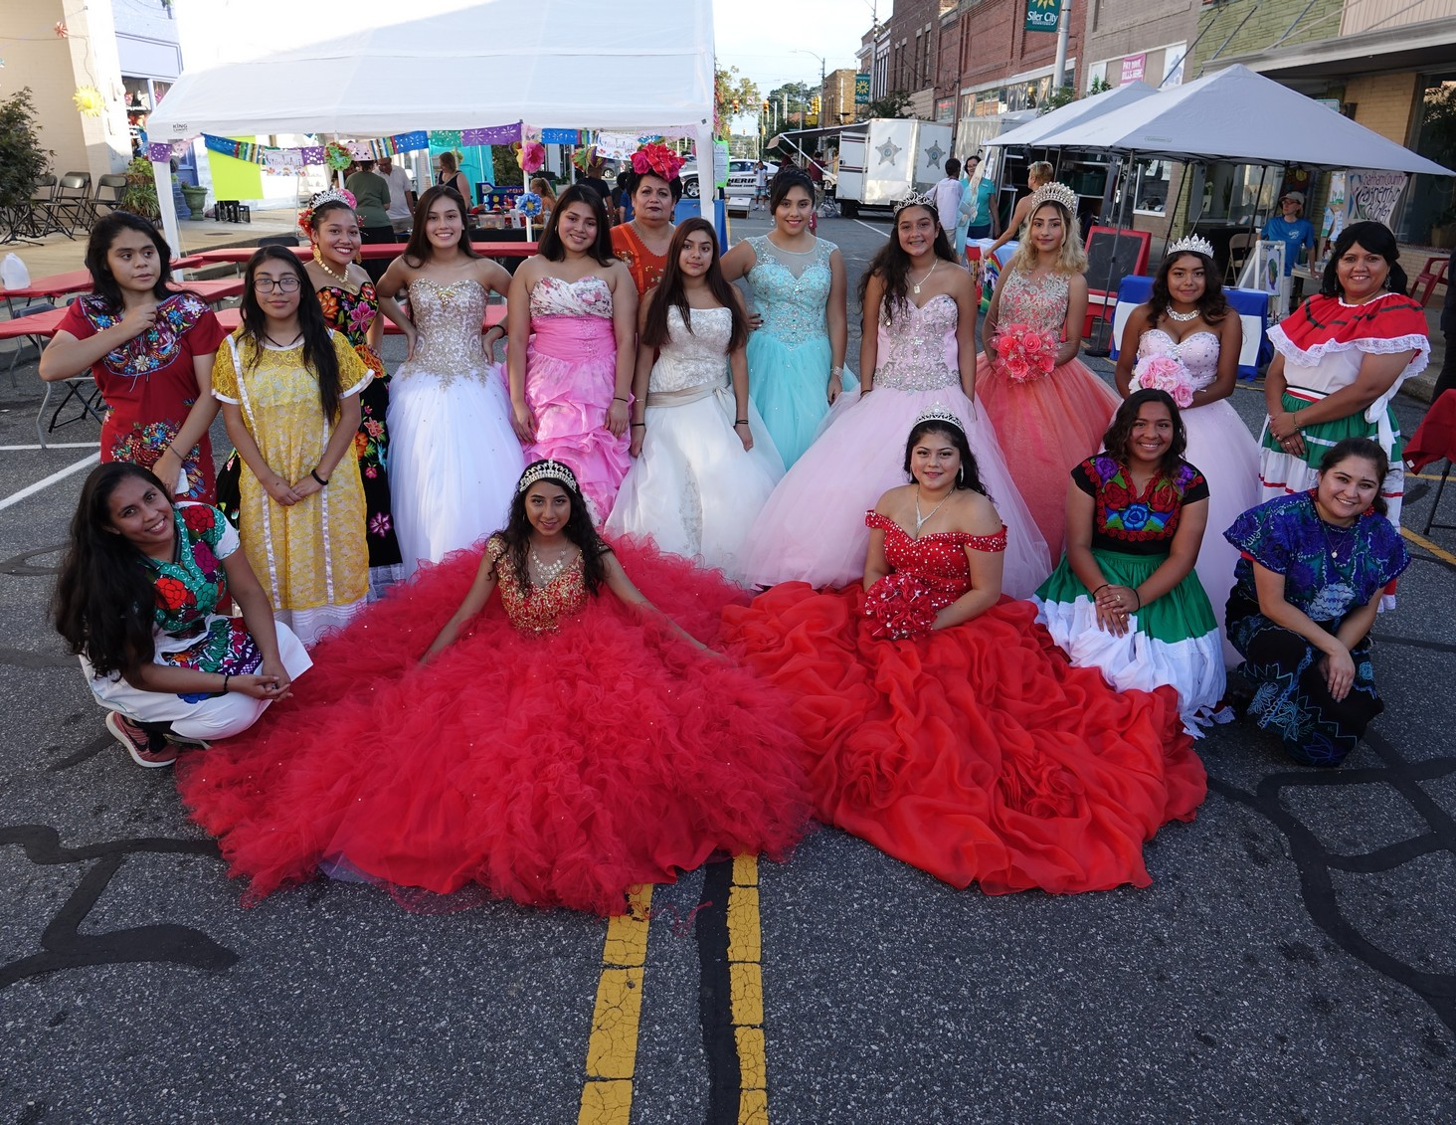
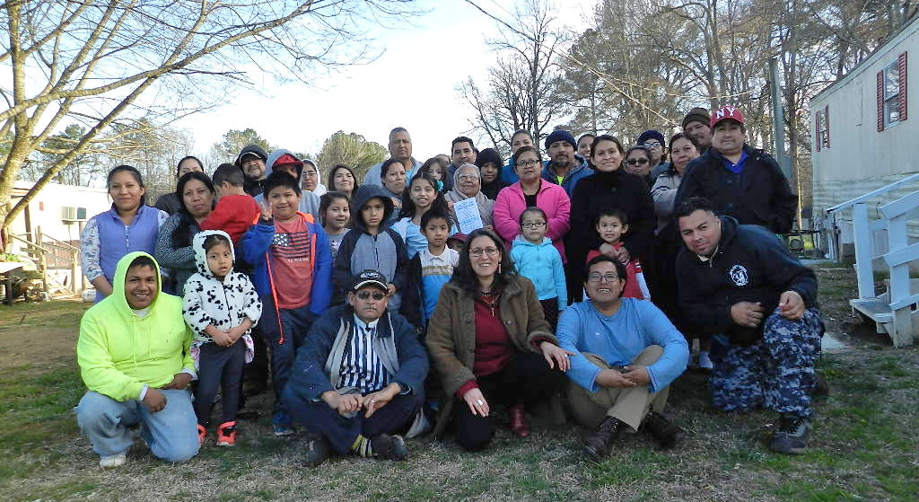
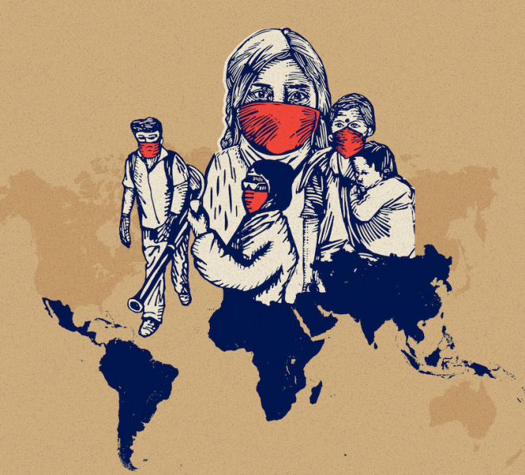
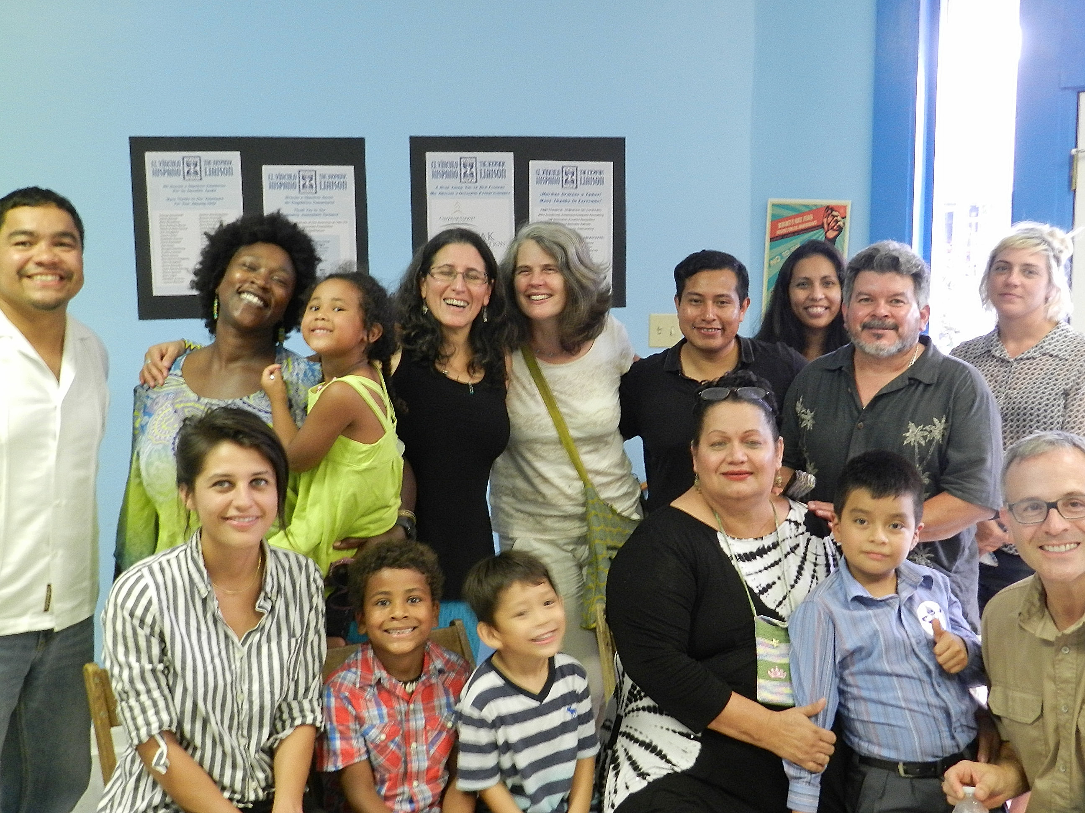
Chatham County Programs
Orgullo Latinx Pride (OLP)
Worker’s Rights Project
Hispanic Arts & Culture
Advocacy & Civic Engagement
COVID-19 Rapid Response
Community Support

Slide 7
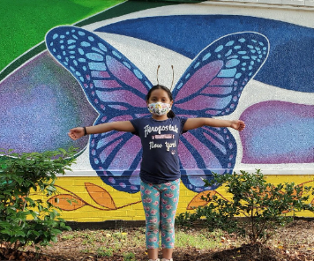
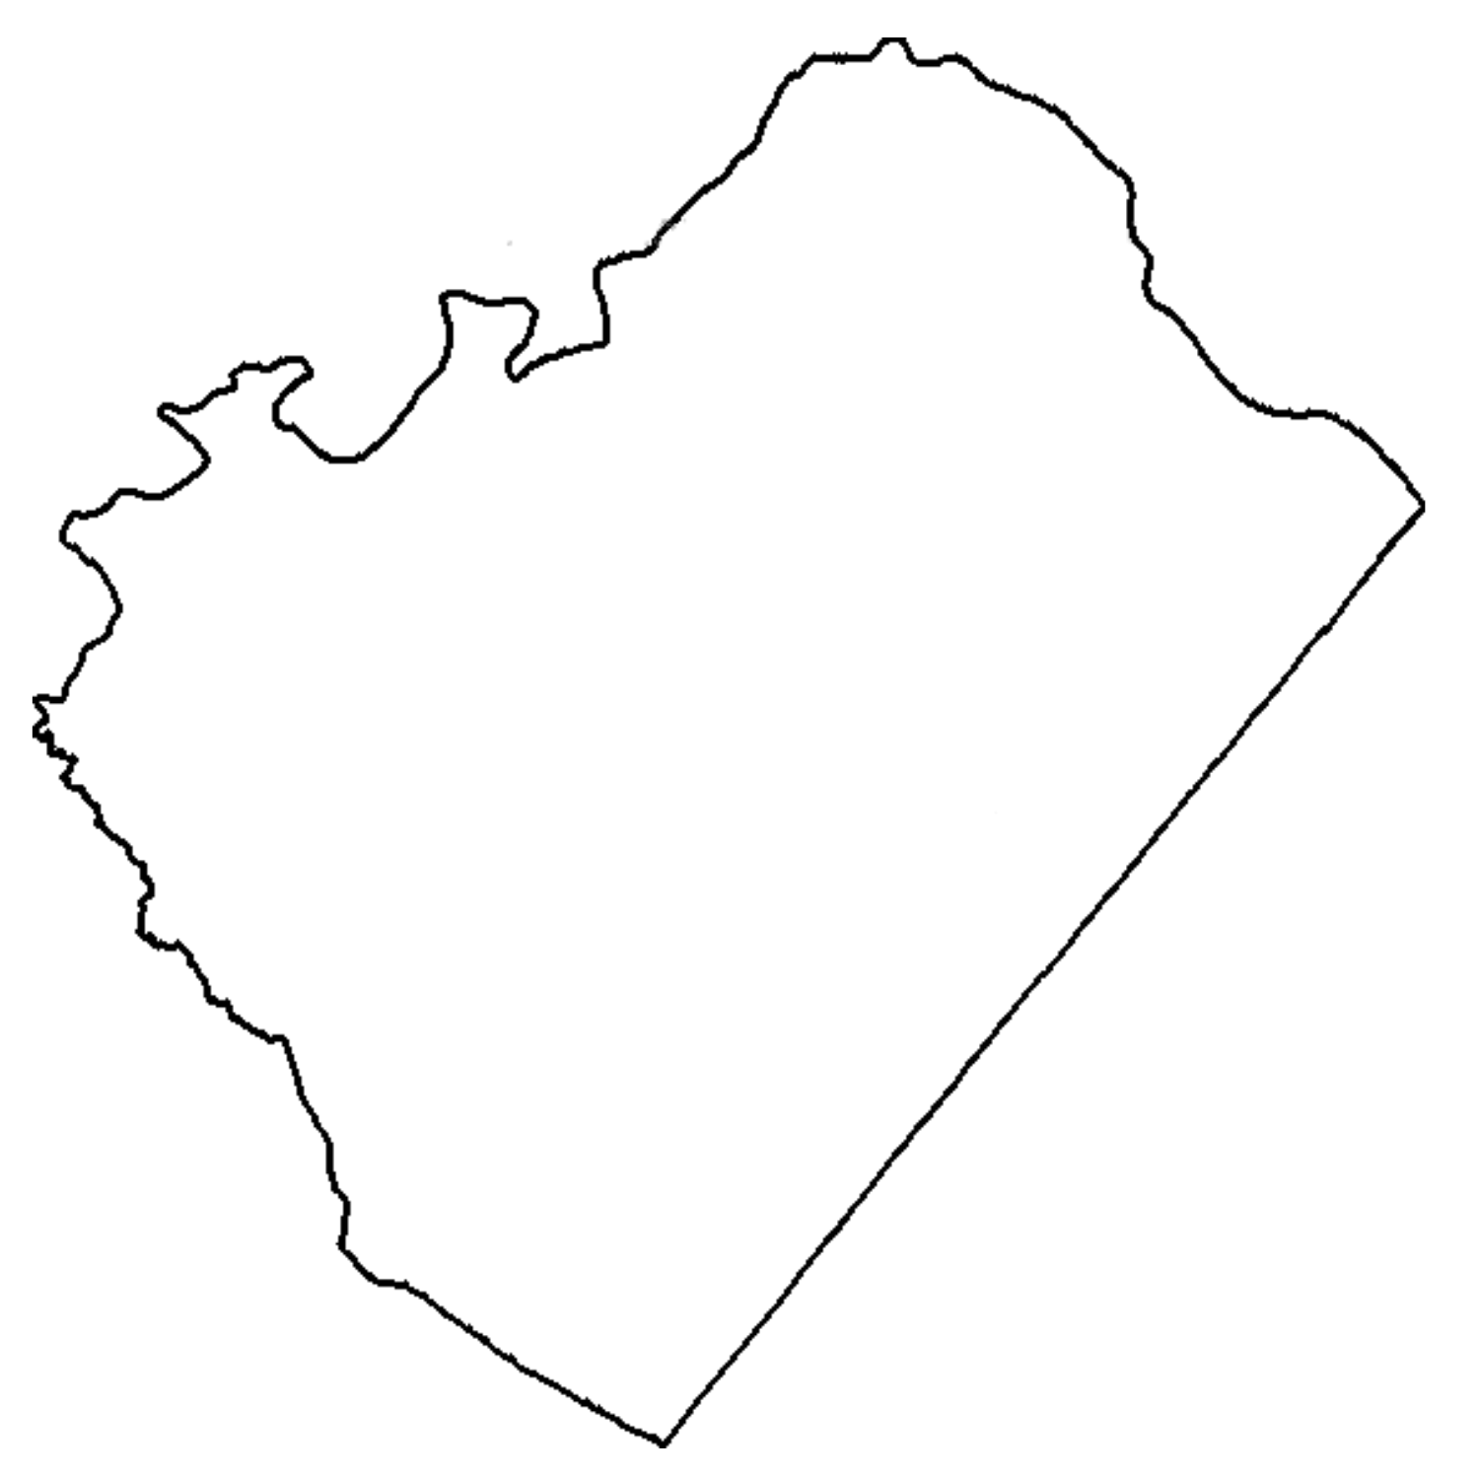


EVH in
Lee County
Need
Opportunity
Local Support

Slide 8

Lee County
Community Support For
Latinx Families
Individualized Assistance
Problem Solving
Referrals
Information
Assistance in obtaining important documents: passports, birth certificates, marriage licenses, ITIN numbers, etc.
Community Education & Outreach
Covid-19 response
Advocacy
Virtual Immigration Legal Clinic

Slide 9

Equity
EVH is committed to equity, diversity and inclusion. We do not discriminate on the basis of race, color, national or ethnic origin, ancestry, age, religious beliefs, disability, sex, gender identity, or sexual orientation.

Slide 10





Stay in Touch!
919-742-1448
www.evhnc.org
Ilana Dubester
Executive Director
ilana@evhnc.org
Cell: 919-260-6210
200 N Chatham Ave | Siler City, NC 27344
@facebook.com/evhnc
@HispanicLiaison
Hannia Benitez
Deputy Director, Lee County Office
hannia@evhnc.org
Cell: 910-489-2641
Sanford Address TBA
@evh_nc
Hispanic Liaison
https://hispanicliaison.org/sign-up-for-updates/

