Slide 1

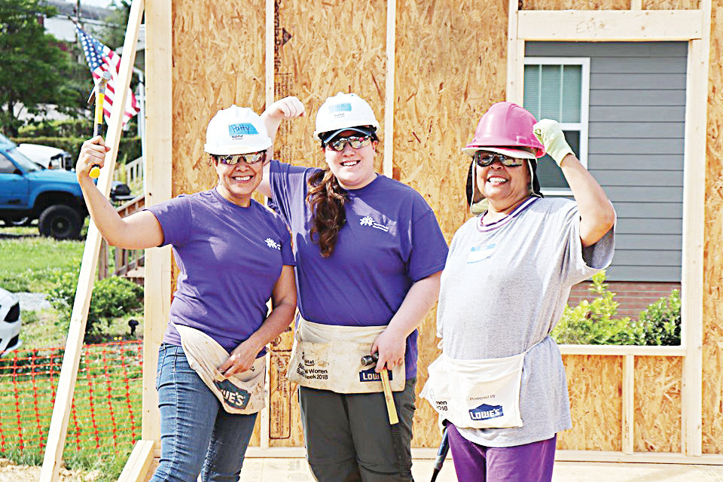
31 years of partnership: 1989 - 2021
simple houses … profound impact

Slide 2
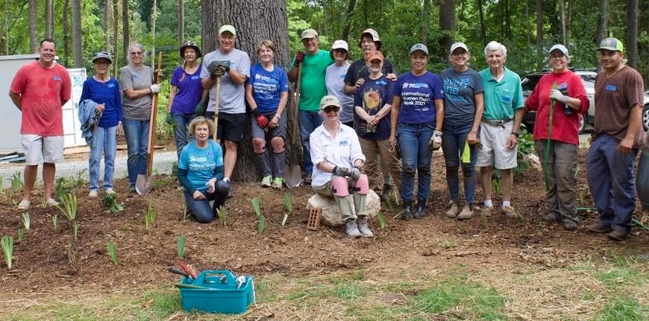
Intro To Habitat For Humanity
Chatham Habitat for Humanity is an affiliate of Habitat for Humanity International (HFHI), founded in 1976 by Millard and Linda Fuller and based in Americus, Georgia. We are a nonprofit, ecumenical, Christian housing ministry seeking to eliminate poverty housing in Chatham County through bringing families in need together with communities, volunteers, and resources to make simple affordable homes a matter of conscience and faith in action
Chatham Habitat for Humanity was founded in 1989 and to date has built 146 homes for qualified families in Chatham County. Currently working with 5 families building 5 more houses for a total of 151 houses in 2021)

Slide 3
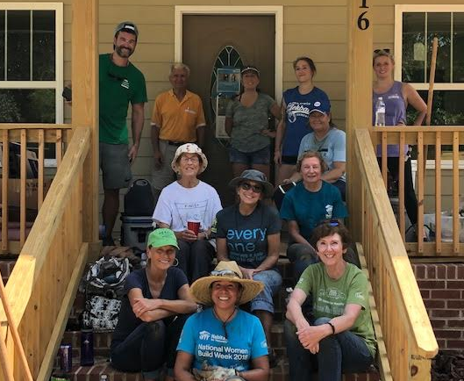
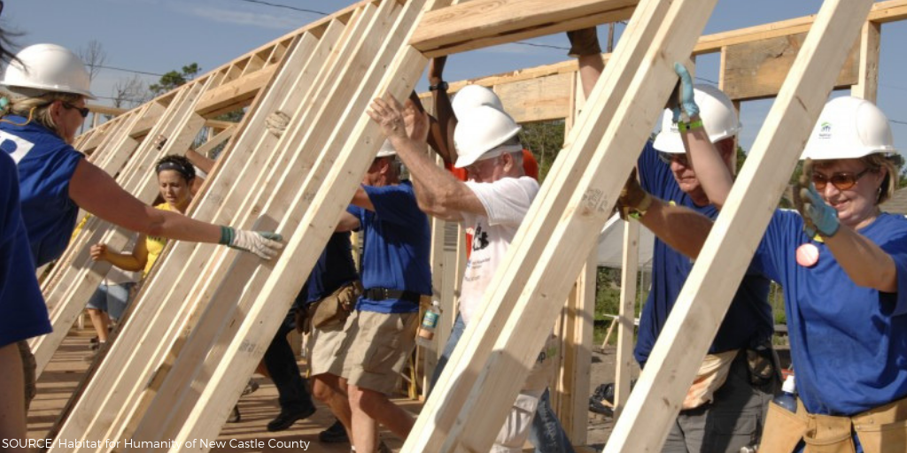
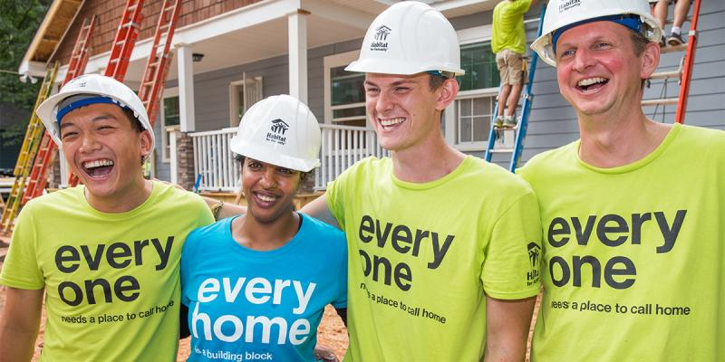
What do we do?
  We are a nonprofit organization that seeks to provide the opportunity of homeownership to low/Medium income families who might not qualify for a mortgage on the conventional market.
  By using volunteer labor and donated money and materials we are able to provide a 20-33 year interest free mortgage to qualifying applicants.
Notes:
3
-Non-discriminatory org. We work with people of all genders, sexual orientations, nationalities etc.

Slide 4
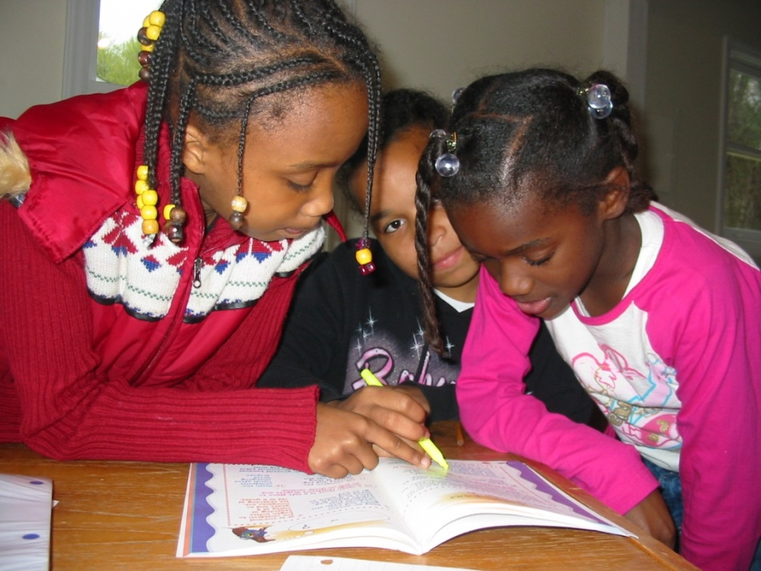
Mission
Chatham Habitat for Humanity works in partnership with God and people
to create
self-help opportunities
for families to
own affordable homes,
improve their lives and
strengthen their communities.

Slide 5
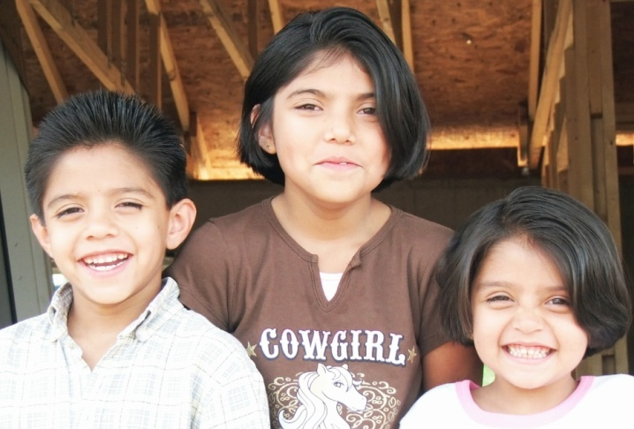
Three basic criteria for our homeownership program:
1. Need for adequate shelter
Willingness to be an active Partner with Chatham Habitat.
3. Ability to pay
Notes:
5

Slide 6

1. Need for adequate shelter
Structural, safety, or health issues
Staying with family members
Paying more than 30% of income for housing
Overcrowded, more than 2 people per bedroom
Notes:
6
-Are you living with multiple families under one roof?
-Do your monthly living expenses (mortgage + bills) add up to more than 35% of your monthly income?
-Leaky roofs, deteriorating floors insufficient protection from the elements?

Slide 7

2. Willingness to partner
Participate fully in the application process
Commit to a minimum of 250 sweat equity hours
Attend Homebuyer’s Education classes
Notes:
7
Each adult head of household is required to put in 140 hours of Sweat Equity. Friends and family can do the difference (70 hours).
-Classes are mandatory

Slide 8


3. Ability to pay
Fall within income range based on the size of your family
  Household income of 25-60% of median income
  Family of four qualifies if they earn $ 22-54K/year
2021 Median Income for Chatham County: $86,400
Family Size | 25% of median Income | 60% of median income
1 | $15,125 | $36,300
2 | $17,300 | $41,520
3 | $19,450 | $46,680
4 | $21,600 | $51,840
5 | $23,350 | $56,040
6 | $25,075 | $60,180
7 | $26,800 | $64,320
8 | $28,525 | $68,460
Notes:
8
-Income from all members of the household above 18 years of age.
-Includes public assistance, child support, alimony
DO NOT WANT TO PUT A FAMILY IN A SITUATION WHERE THEY CAN’T MEET THEIR MONTHLY OBLIGATIONS>

Slide 9
3. Ability to pay
Able to afford payments of $490-$650/month
Less than 41% debt to income ratio
No current bankruptcy or judgment
Show a history of making payments
Notes:
9
-Income from all members of the household above 18 years of age.
-Includes public assistance, child support, alimony
DO NOT WANT TO PUT A FAMILY IN A SITUATION WHERE THEY CAN’T MEET THEIR MONTHLY OBLIGATIONS>

Slide 10
The Application Process
Turn in application and all supporting docs
Letters are sent out to verify income, rental history and debt
Credit report and background check
Home visit
Family Selection committee reviews application
Board of Directors gives final approval

Slide 11
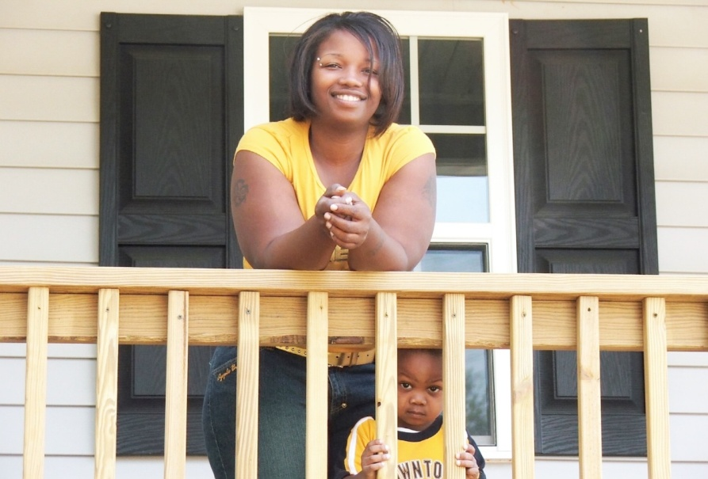
The Mortgage
0% interest
20-33 years
Pay less than 30% of Gross income for mortgage payment
Payments $490-$650 per month
  Homeowners Insurance
  City and County taxes
  Termite inspection
  Homeowners Association dues

Slide 12

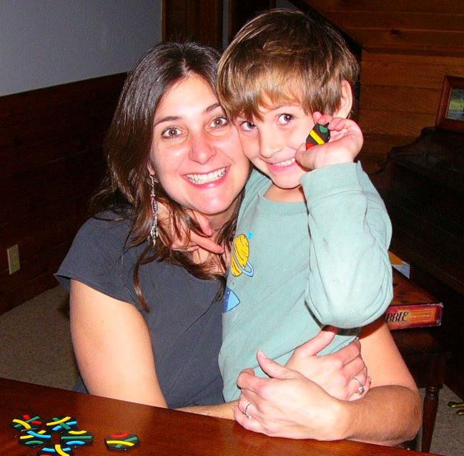
Partnering with Chatham Habitat for Humanity →
Home Ownership
is possible!

Slide 13
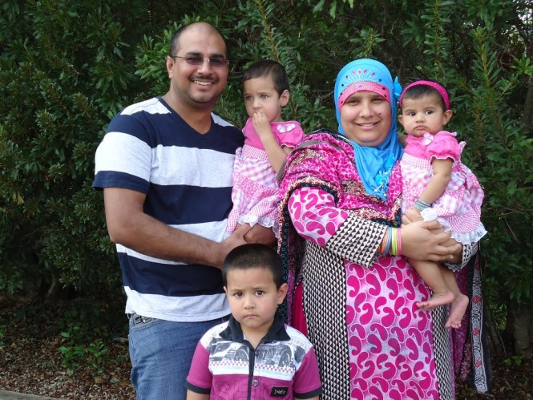
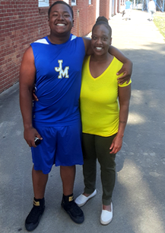
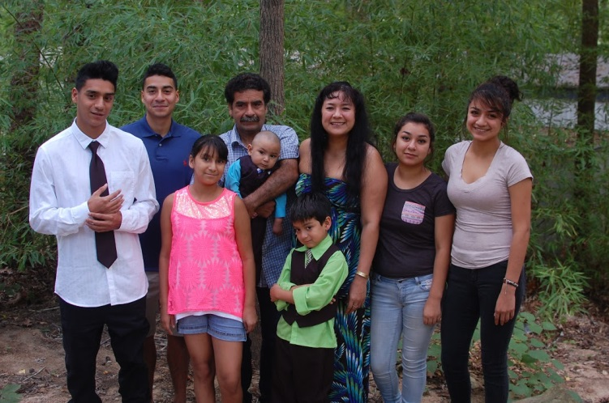
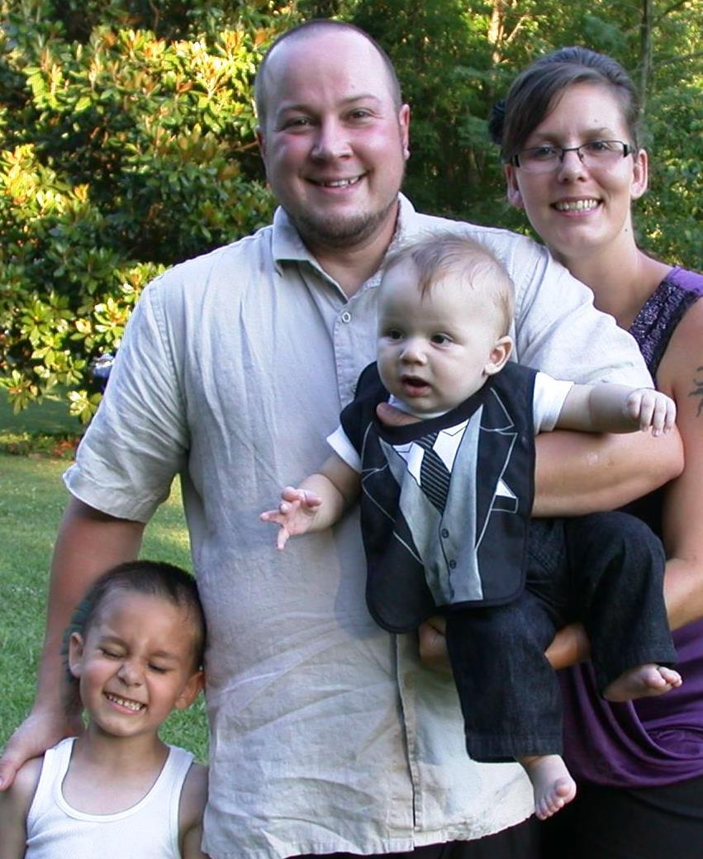
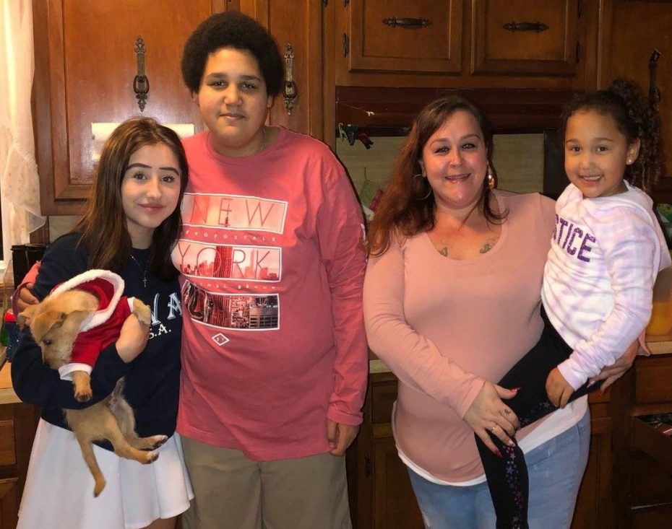
It is Possible to own your own home!
The Usman Family
Robert’s Rd., Pittsboro
The Weaver Family
Siler City
The Vazquez Family
Robert’s Rd., Pittsboro
The Johnston Family
7307 Old US 421, Bear Creek
The Boone Family
S Second Ave., Siler City
Notes:
13

Slide 14
Frequently Asked Questions!
How long does the application process take?
When can I move in?
What if I don’t qualify?
My credit is not great, will that disqualify me?
Can you build on my land?
What if I don’t currently live in Chatham County?
What if I am not married or don’t have kids?

Slide 15
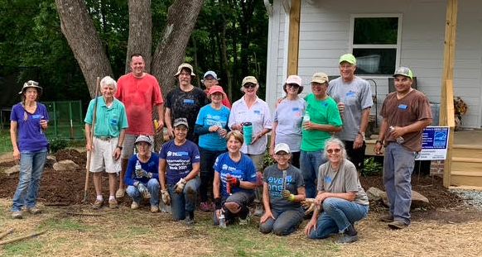
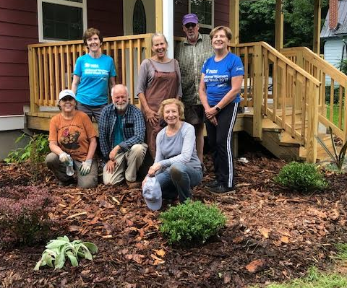
Please remember…
Every interaction is an
opportunity!
Word of mouth is #1 reason families apply
“Believability” is a huge hurdle
Customer service is extremely
important
ALWAYS get contact
information!!!!

Slide 16
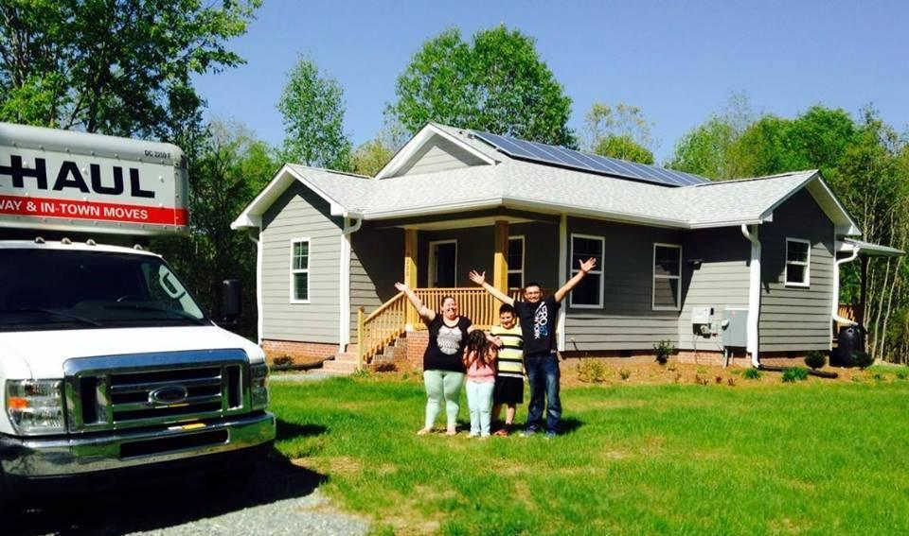
After Selection
250+ hours sweat equity
Homebuyers education classes
Dedication
Pre-closing
Maintenance walkthrough
Closing
Move in!
1 year warranty

