Slide 1
Student Retention

Slide 2
In the Classroom- Active Teaching
Role Playing
Case studies
Group Projects
Think-Pair-Share Activities
Peer Teaching
Debates
Short Demonstration followed by class discussion
Questioning

Slide 3
Ways to Encourage Retention
When Learners are Absent
call/text learner
Multimedia contact- email, text, Facebook, WhatsApp
Snail Mail- letters of encouragement, postcards

Slide 4
Ways to Encourage Retention
In the Classroom
Variety of instructional approaches
Positive teacher and learner interaction
Recognition of progress
Teacher knowledge

Slide 5
Learner Centered Instruction
Flexible Options
Support & Counseling
Relevant Adult Content
Teacher interaction
Multimedia instruction
Active teaching strategies

Slide 6
Goals Can Motivate & Motivation Drives Learning
“Motivation is the process that initiates, guides, and maintains goal-oriented behaviors”
Extrinsic Vs Intrinsic
When you're extrinsically motivated, your behavior is motivated by an external factor pushing you to do something in hopes of earning a reward -- or avoiding a less-than-positive outcome.
Adults are responsive to some external motivators
(e.g. better jobs, higher salaries, rewards, praise…)
Notes:
Intrinsic motivation involves doing something because it's personally rewarding to you. Extrinsic motivation involves doing something because you want to earn a reward or avoid punishment.

Slide 7
BUT
The most effective motivators are internal
(e.g. desire for increased job satisfaction, self-esteem, sense of attainment, curiosity, interest, pride)
Tap into your learner’s desire
What are their motivations?

Slide 8
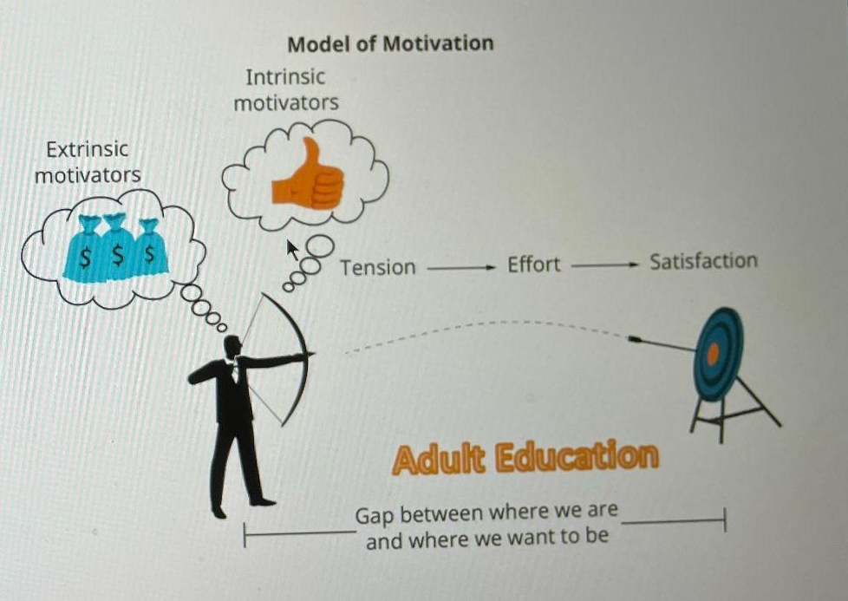

Slide 9
Orientation is Critical
Research Shows that a Complete orientation improves retention
Orientation also improves student satisfaction and outcomes
Consider-Review key intake information- time to connect showing interest and caring
Make special notes of academic accomplishments, birth dates, hobbies- used as talking points for conversations

Slide 10
Set Expectations
For both the program and the learner
Goal setting- revisit those goals
Attendance, program guidelines, and responsibilities (program and learner)
Discuss obstacles or barriers and explore multiple solutions for each one

Slide 11
Updates
Holiday Festival with United Way: Sat Dec 3 2pm-5pm, Food trucks + family fun
Tutor Appreciation Potluck: Next Tuesday 6-7:30pm
Tutor Reports due: Turn those in to Oscar at Oscar@chathamliteracy.org

