Slide 1
Assessment Breakdown

Slide 2
Your student was assessed, now what?

Slide 3
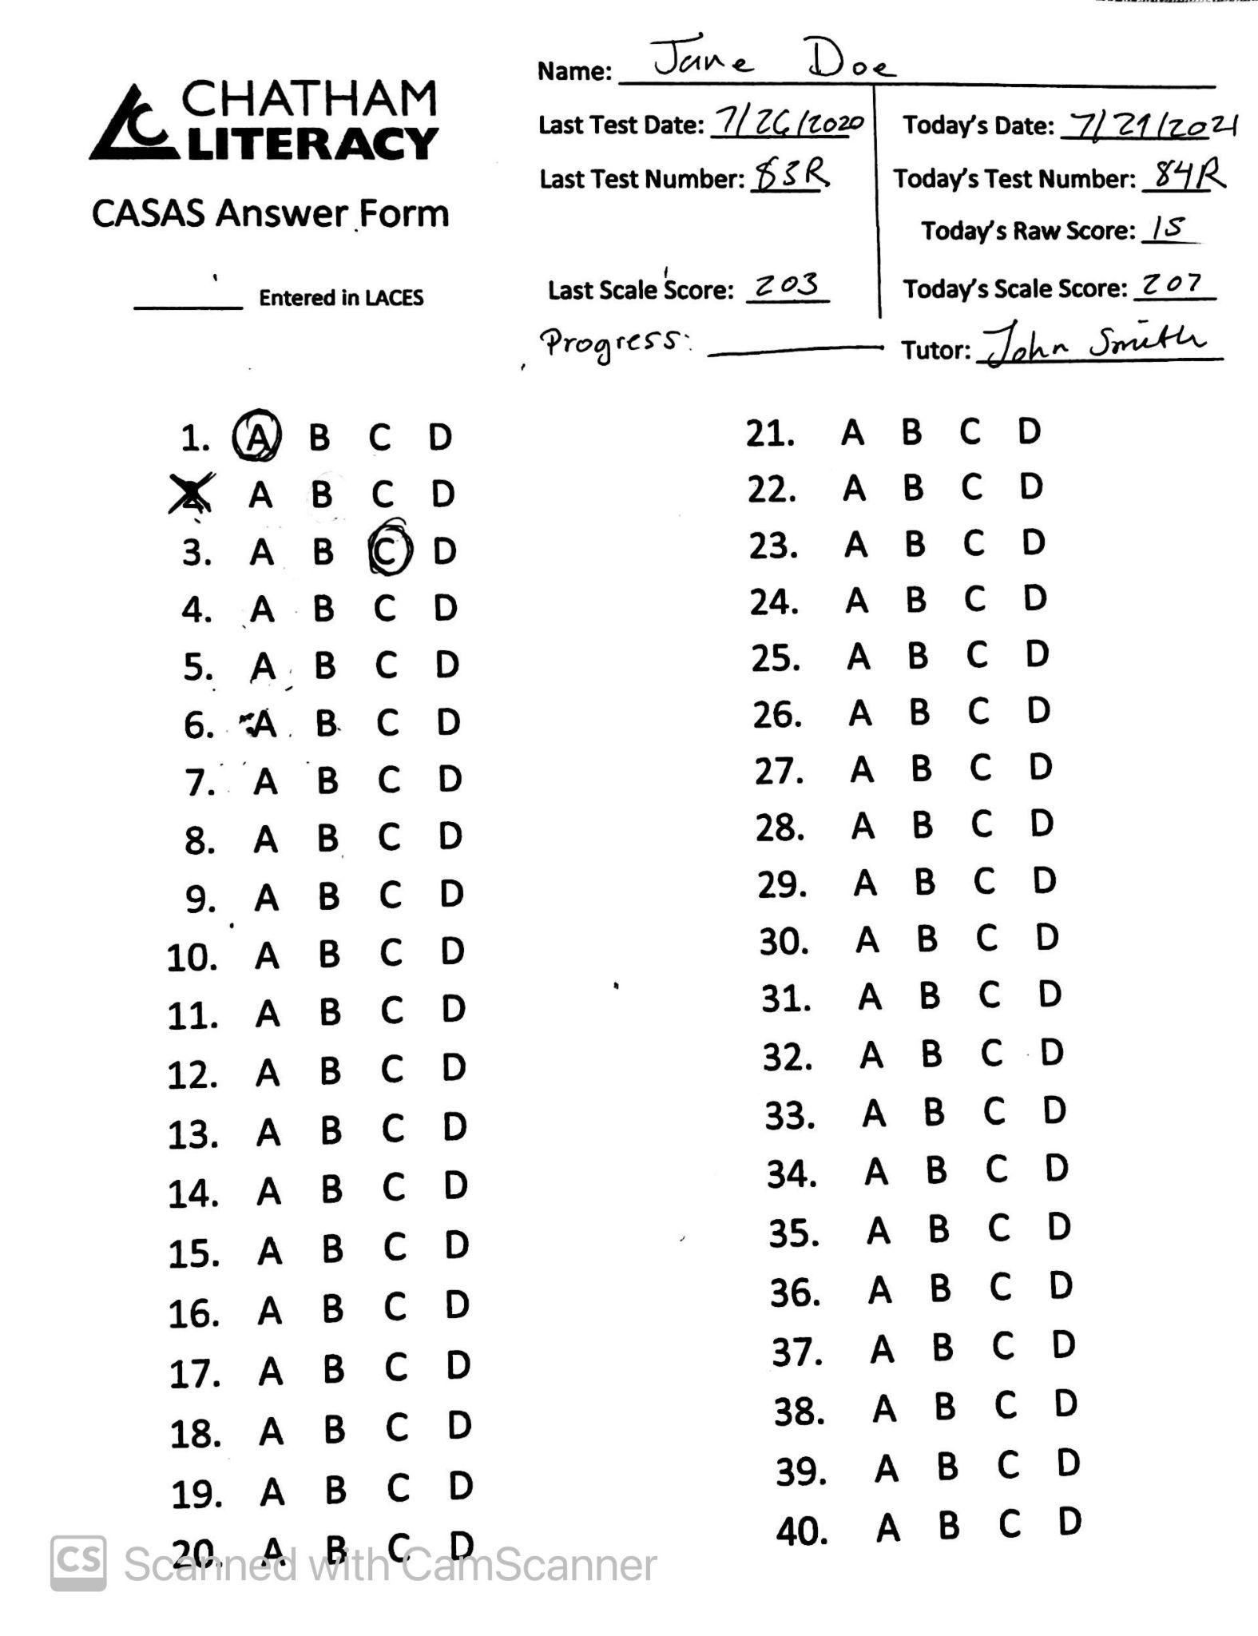

Slide 4
You have a competency sheet, now what?

Slide 5
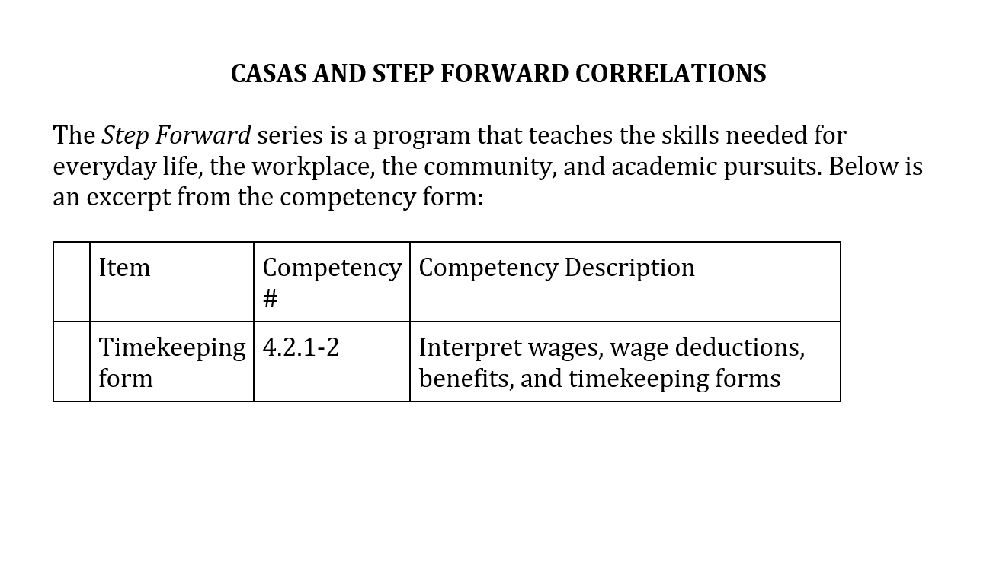

Slide 6
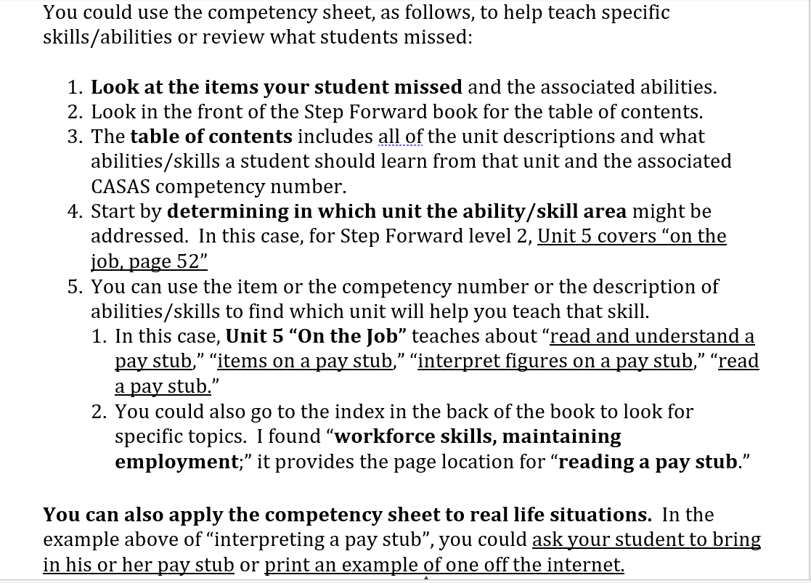

Slide 7
CASAS Score
Test Number
ESL Level
GLE (Grade Level Equivalent)
Question Breakdown
Your Competency Sheet Has the Following

Slide 8
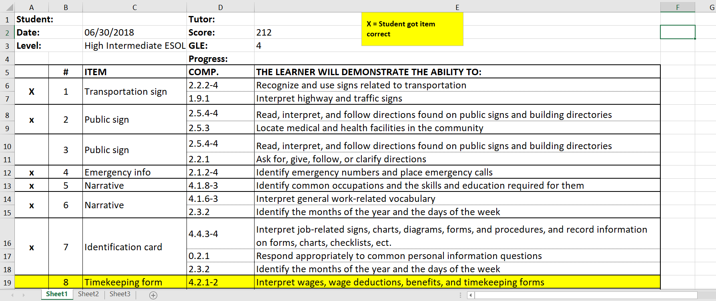

Slide 9
CASAS Score
Student’s Level is based on their score
The following shows how levels calculated based on score

Slide 10
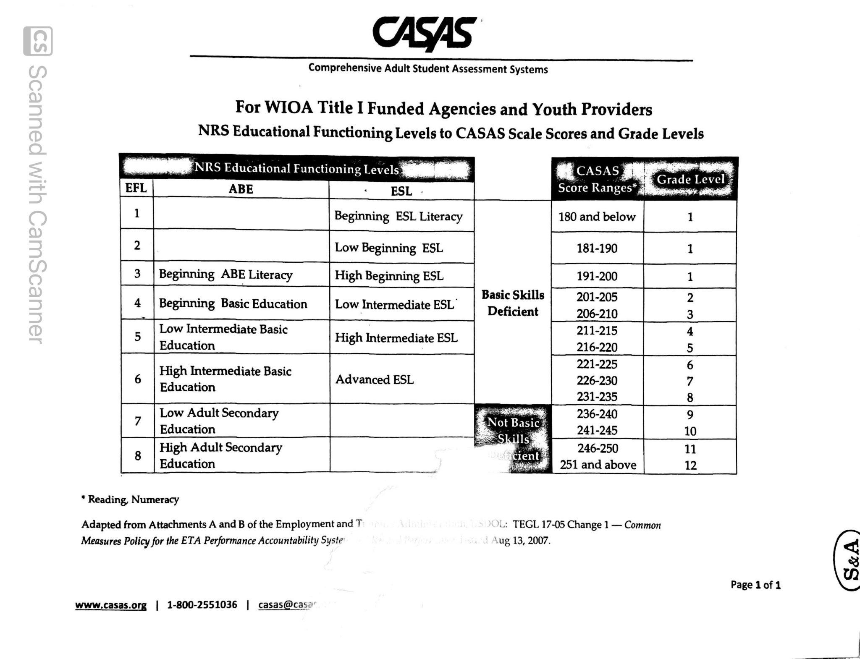

Slide 11
Test Number

Slide 12
ESL Level

Slide 13
GLE (Grade Level Equivalent)

Slide 14
Question Breakdown
CASAS and Step Forward
Following Slides Provides an example

Slide 15
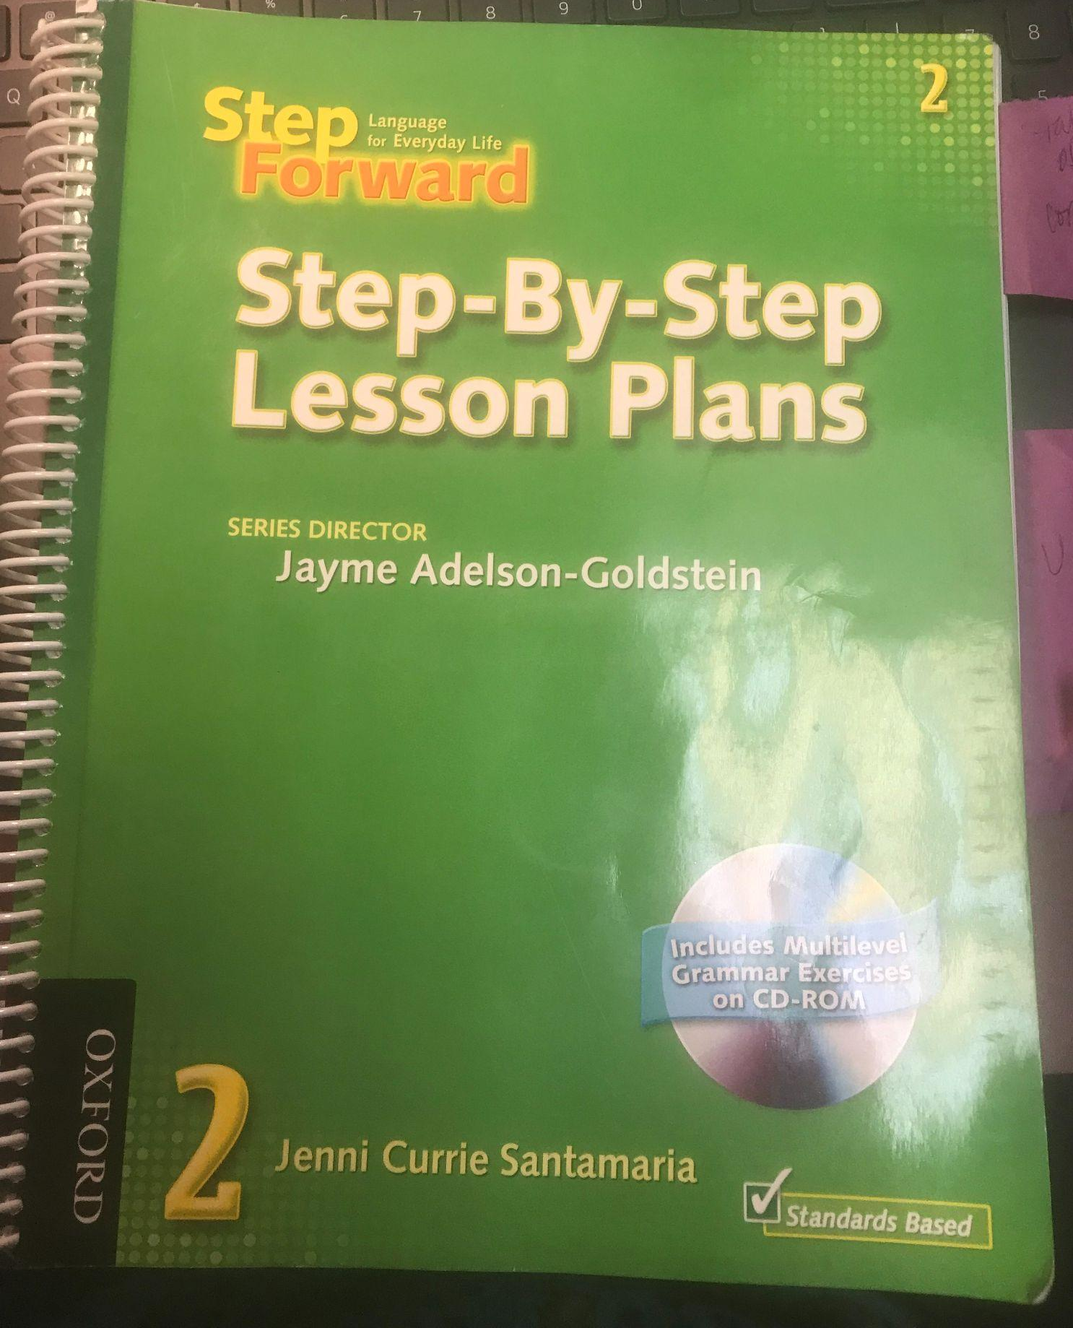

Slide 16
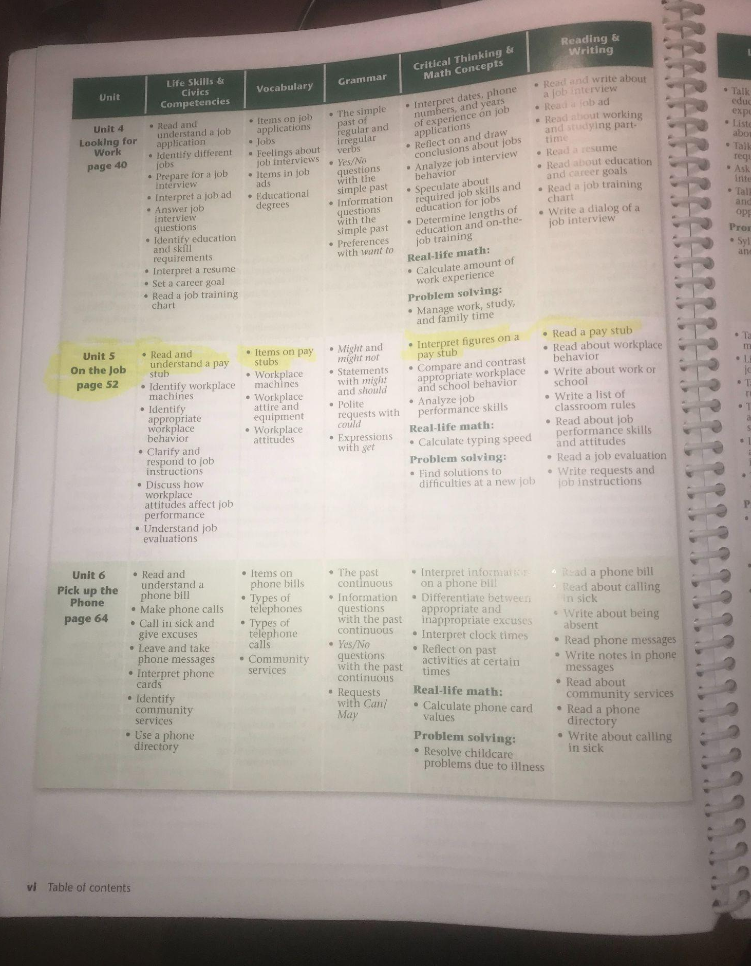

Slide 17
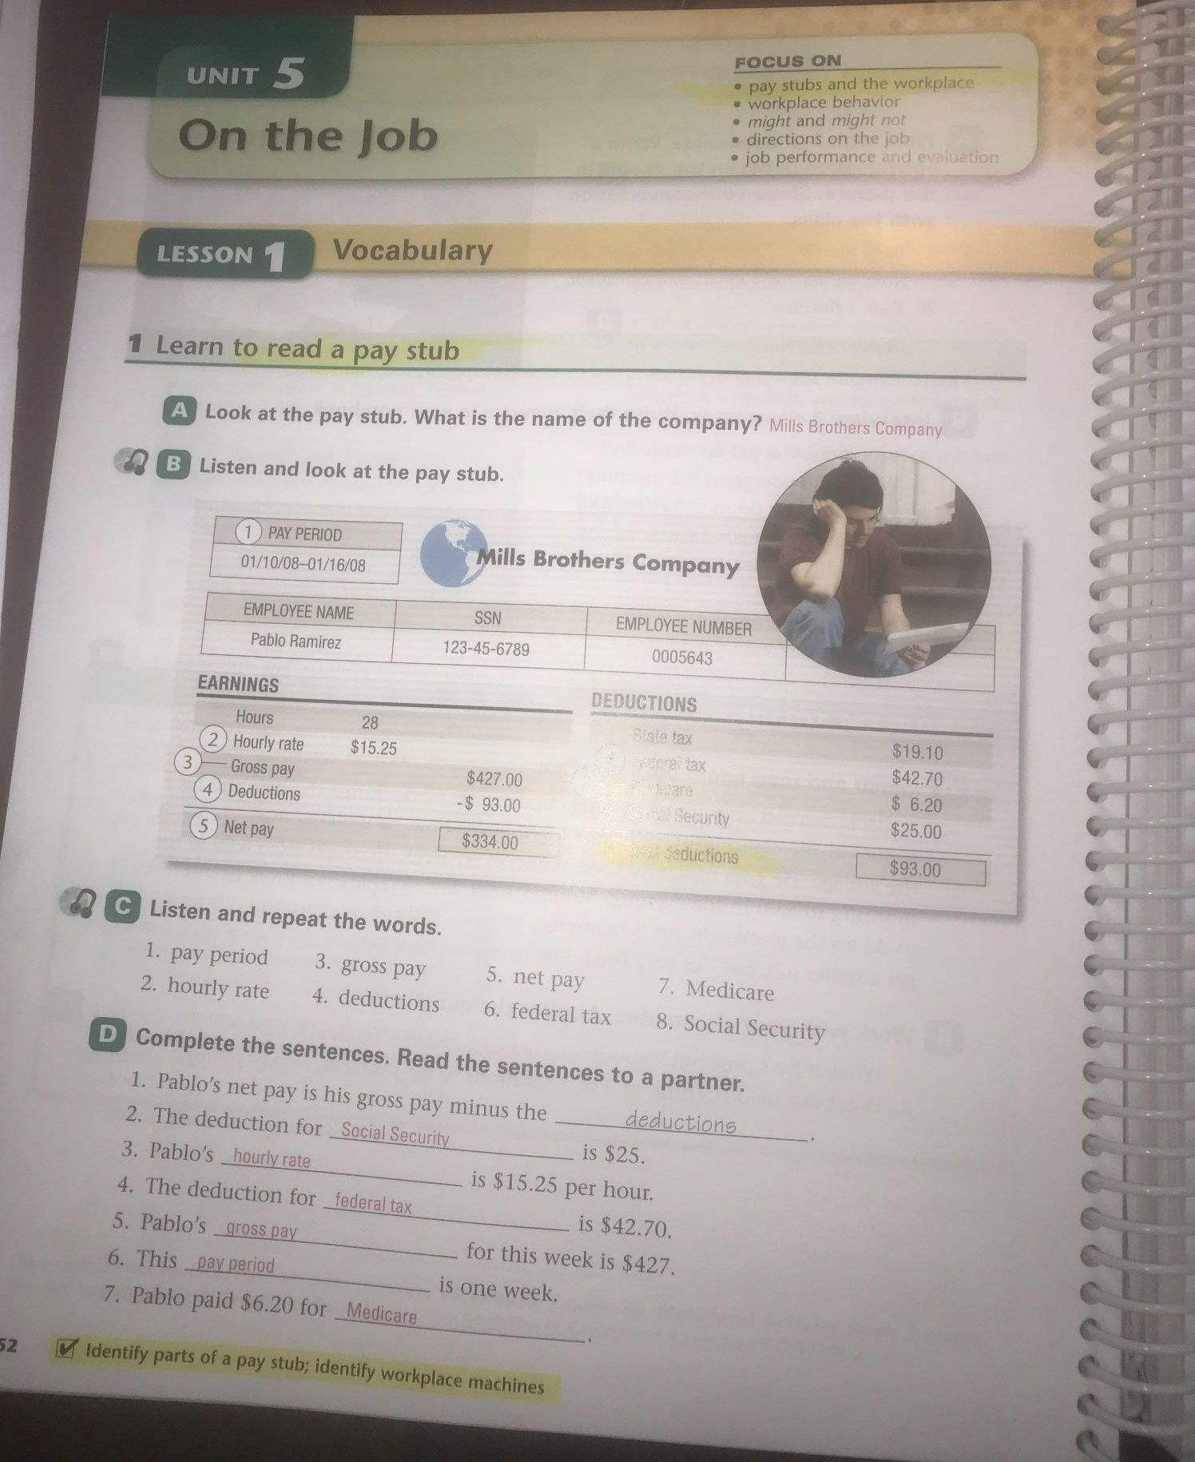

Slide 18
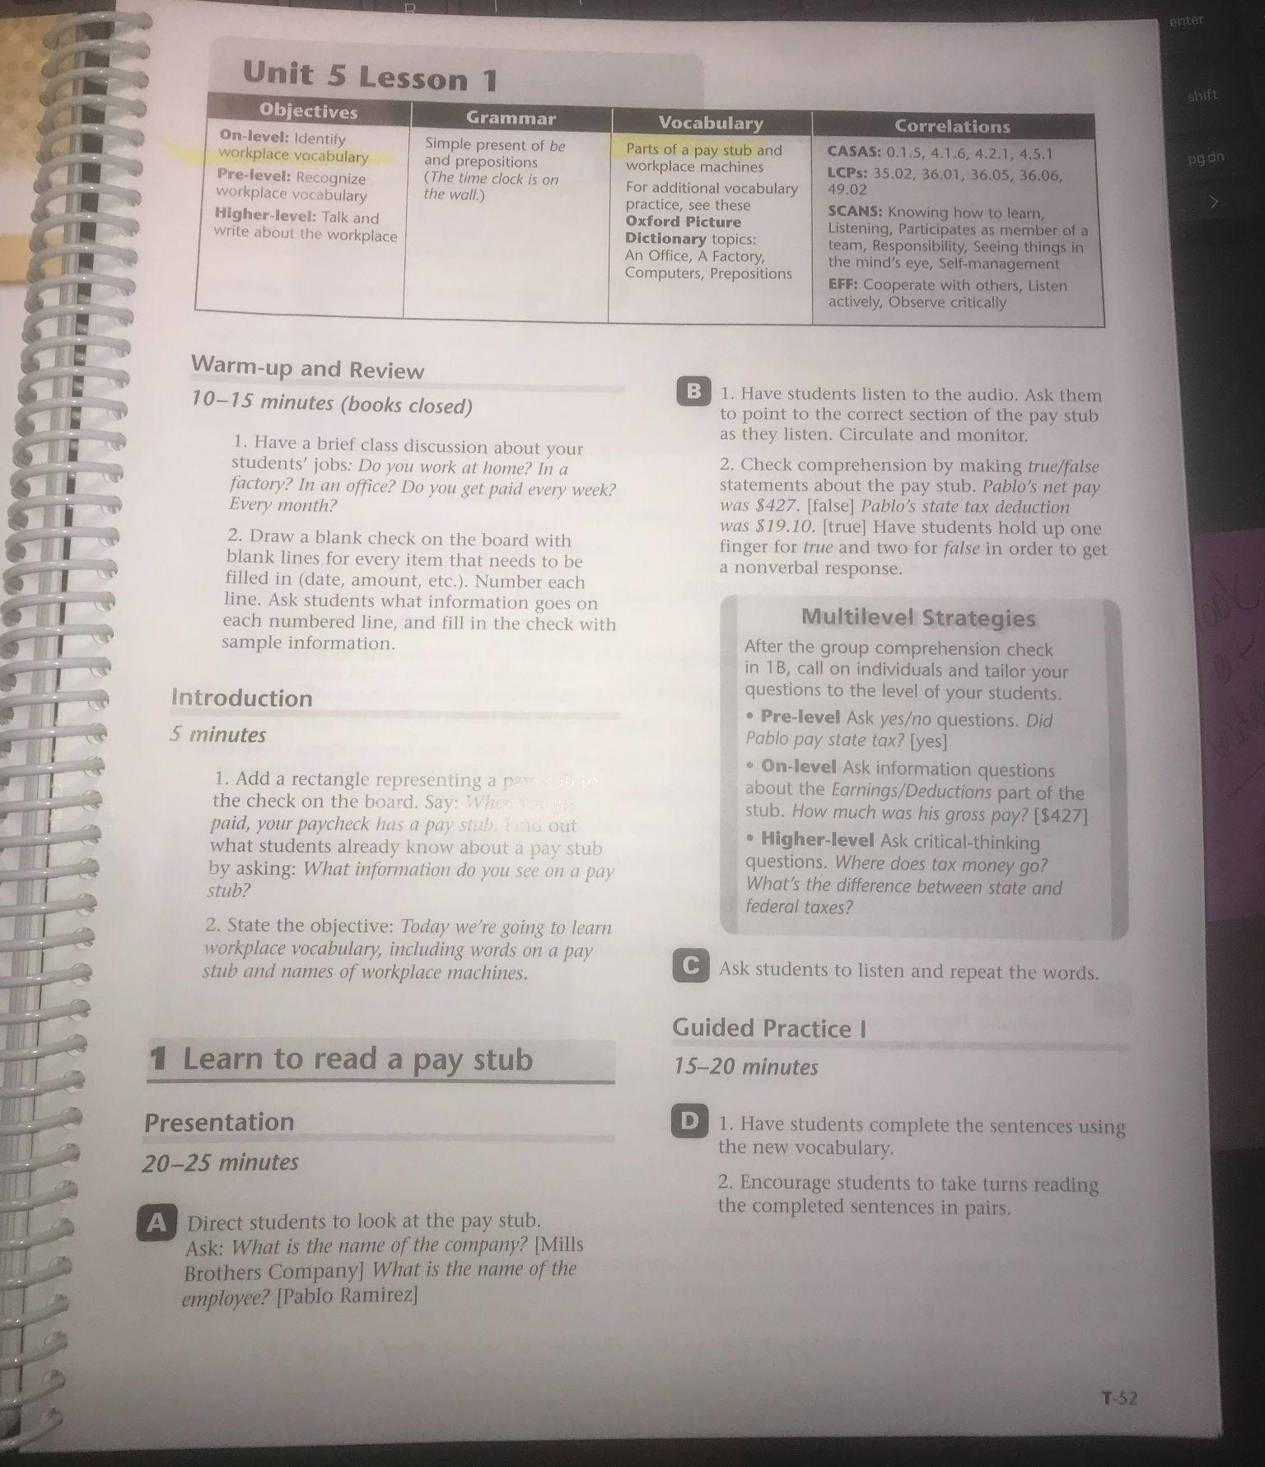

Slide 19
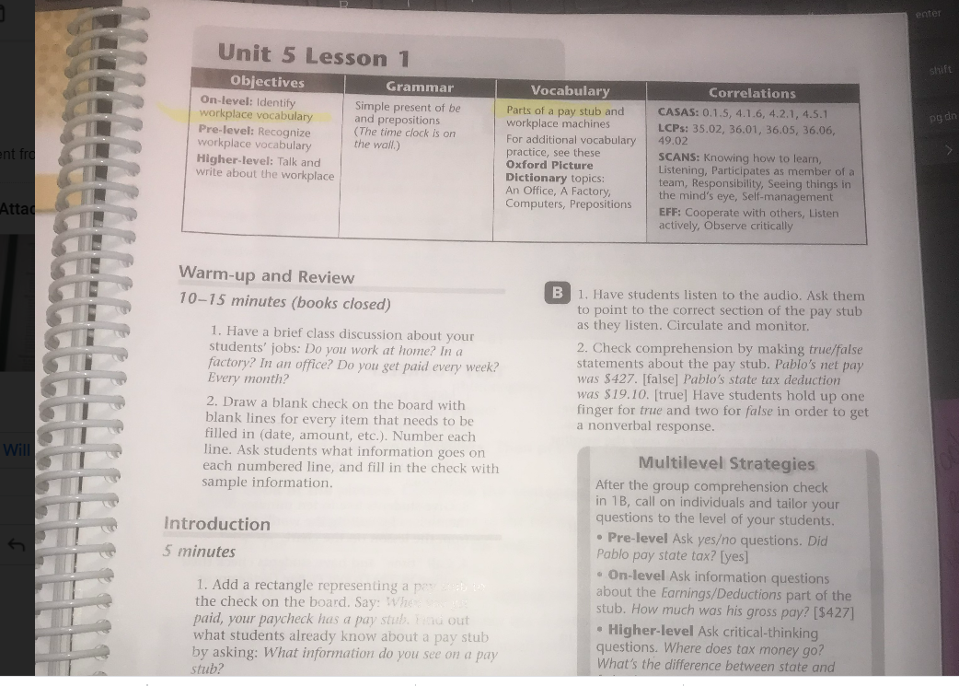

Slide 20
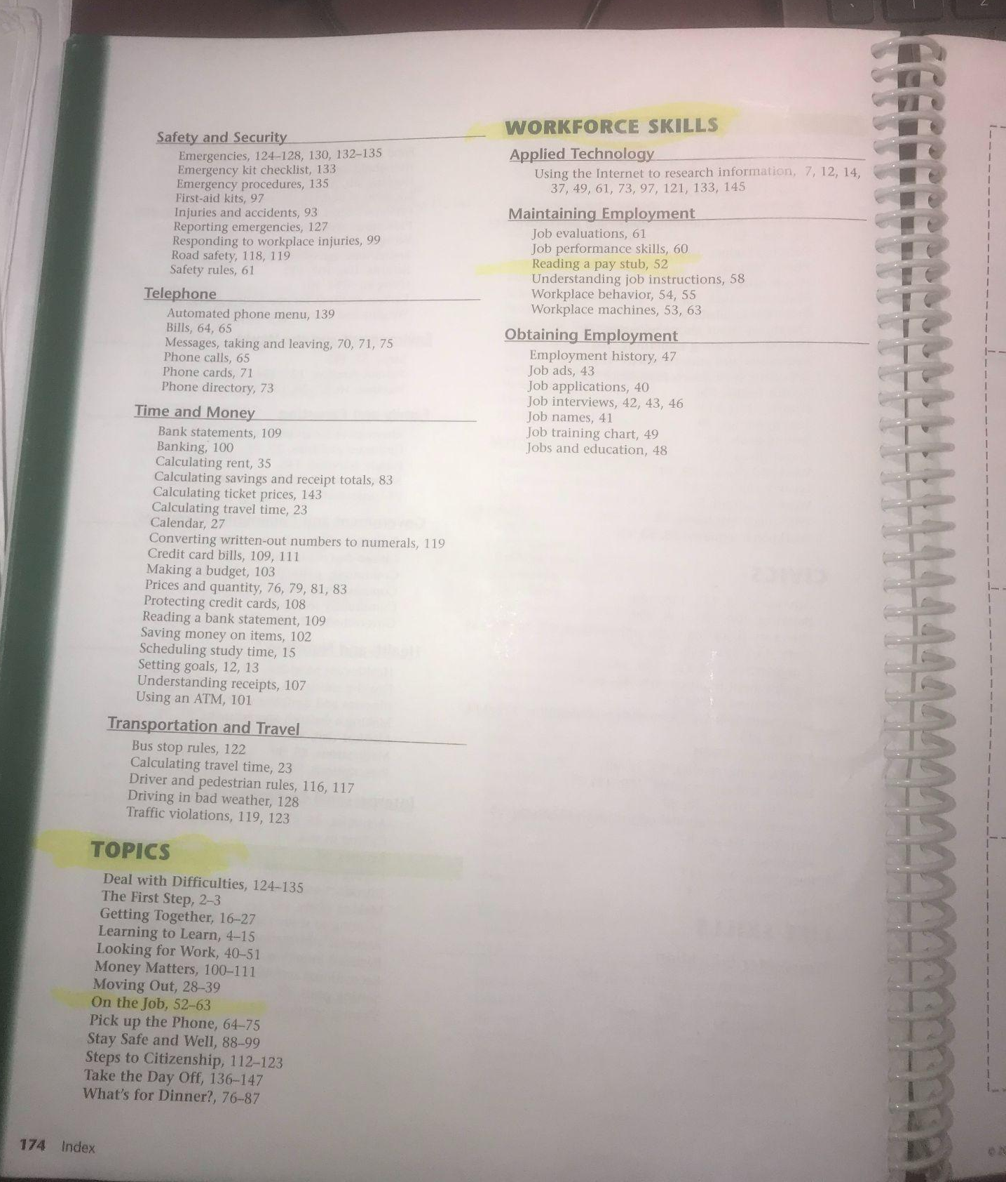

Slide 21
Questions?

